Slide 1
A Half-century of Supercomputing History Personal Reminiscences:
Engineer, researcher, bureaucrat, supporter, investor, critic, & historian of the amazing race.
Gordon Bell
Microsoft Research, Silicon Valley Laboratory
-
Supercomputing 2014, 18 November
For IEEE Seymour Cray Engineering Award
Notes:
I want to give you a view of supercomputers, a computer class that I’m fond of and one that you are unlikely to encounter in nature. I find it the most interesting of all computing because it is a race almost from the beginning when the designers were all from the Greatest Generation coming from WWII. From this you get ideas that drive other parts of computing. You also get a lot of interesting people… not household names.

Slide 2
Abstract
On visiting Livermore and seeing LARC a half century ago, I marveled at a kind of large computer built at the edge of technology and a market’s ability to pay. As a machine builder, researcher, administrator, supporter, investor, critic, and historian there’s nothing quite like supercomputers. I’ll posit the mono-memory mono-computer aka SR Cray computer era and multi-computer era consistent with the 3 era Livermore overview e.g. Rob Neely. The decade (mid-80s) of the search for performance and scaling where about 40 companies lost their lives resulted in the current way--clusters, Beowulf, and MPI. Now with limited gain in clock speed, we all wonder at how to harness the vast parallelism required to maintain the “capability computing” edge… an historic 1000x /decade.

Slide 3
Supercomputing ideas & machines:
Speed, parallelism, standards, & cost
The Cray Era (1965-1995): Mono-memory computer
  Increased clock: high Khz => Mhz => low Ghz (10,000x)
  Intra-processor parallelism techniques (10x > 100x vector)
  multi-processor parallelism (1>32)
The Multicomputer aka Clusters era (1984-present)
  Parallelism: <10 => 1000x => 10,000 => 100,000 => million… billion
  Now it is up to programmers to exploit parallelism
“Killer Micros” transition (1984-1994)
  Searching for the way… scalability, CMOS micros, standards, failures
  Similar to search for those first supers, and for xxMD way.

Slide 4
Top 20+ Supercomputing events: recipes, standards, plans, and prizes
Ideas and seminal events
1945,6 EDVAC Recipe and IAS Architecture. Over a dozen IACS were built e.g. Silliac
1957 Fortran first delivery establishes standard for scientific computing… FORTRAN 2008
1965 Amdahl’s Law: single processor vs multi-P’s or vectors
1982, 83 Caltech Cosmic Cube demo of multicomputer with 8, 64 computers. New beginning.
1987 nCUBE (1K computers) 400-600 speedup, Sandia wins first Bell Prize.
1988 Gustafson’s Law as Amdahl’s Law Corollary
1993 Top500 established at prize using LINPACK Benchmark. Begin multicomputer era
1994 Beowulf kit and recipe for multicomputers and MPI-1 Standard established
1995 ASCI > Advanced Simulation and Computing (ASC) Program
1996 Seymour R. Cray is killed in a car accident
Machines
1960 LARC and 1961 Stretch—response to customer demand; 1962 Atlas commissioned
1964 CDC 6600 (.48 MF) introduces parallel function units
1969 CDC 7600 (3.3 MF) introduces pipelining
1976 Cray 1 (26 MF) introduces first, practical vector processor architecture.
1982 Cray XMP… (PK: 1 GF) Intro of mP. The end of the beginning of mono-memory
1992 Intel Touchstone Delta at Sandia? Reaches 100 GF
1993 CM5 (60 GF Bell Prize) 1024 Sparc computers. Cray C90 was 16!
1997 ASCI Red (1 TF) at Sandia
2008 IBM BlueGene (1.5 PF)
2012 Cray Titan (17.6) GPU and CUDA
Tiahne-2 at NUDT

Slide 5
The ideal Supercomputer:
Speed, memory, and parallelism (scaling)
Clock speed that increases with time
One, very large and scalable memory
  Overlap of memory access and instruction execution
  Parallelism of a single instruction stream including look-ahead and execution
  Pipelining
  Vector processing
  Multiprocessors—(Scale up)
  Multiple streams & multi-threading scalability
Multiple independent interconnected computers (Scale out)
aka clusters aka multicomputers
  Multiprocessor nodes aka constellations
  Multi-threading and vector processing
  Stream processing using GPUs

Slide 6
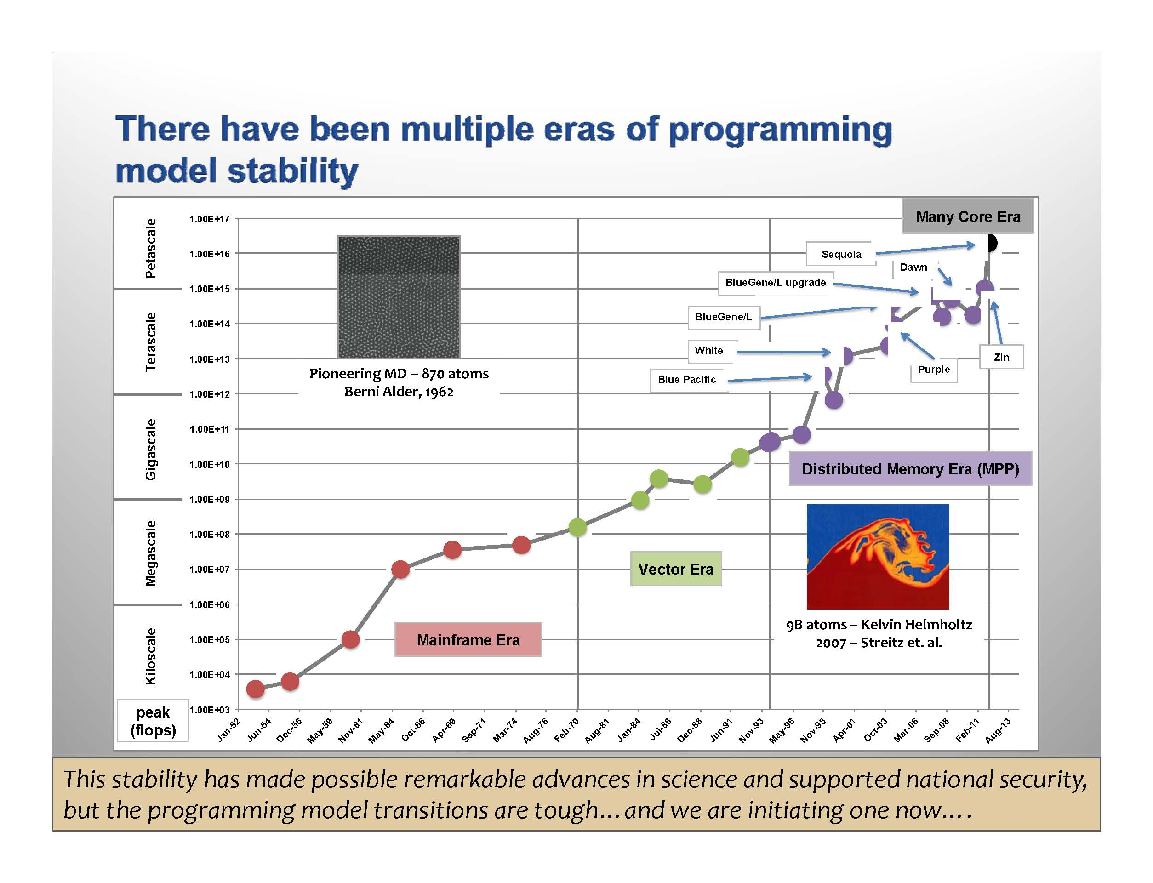
Compatible with LLNL View…
was vector era aka Fortran really different?
CM5
Cray 1
6600
LARC

Slide 7
Seymour Cray
Mono-computers
2x per year (1000x per decade)
40% per year (100x per decade)

Slide 8
Supercomputer attributes
(besides being today’s largest computer)
Function: calculate vs. record processing
Fortran as the higher level “machine language”
Quest for performance: Who can build the fastest? (Capability)
Extend limits: size, power, complexity, …budget
Price: How much do you have to spend?
  To buy, to build the building, to power, to run
  VERSUS
  To program
Use (market): science & engineering simulation, design, climate, cryptography …3d, time varying phenomena
Scalability post 1995: Time, machine generation,
problem size, and programming environments
Programming environment (standards): MPI, Beowulf

Slide 9
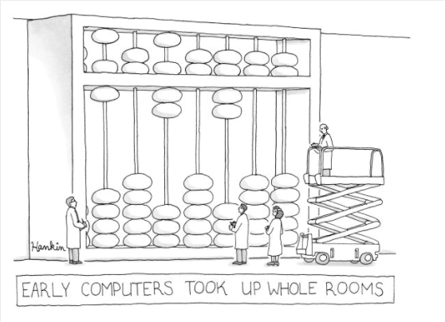
… and we started calling them supercomputers

Slide 10
1960: UNIVAC, IBM, and Manchester U.
Three efforts to build the world’s largest computer establishes a unique computer class for scientific and technical computing
LARC
Stretch
Atlas

Slide 11
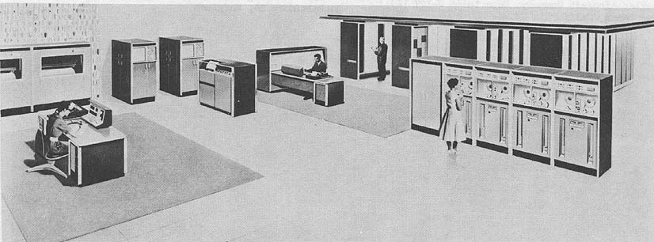
Mainframe? Supercomputer?: LARC
Begun in 1955 for Livermore and delivered in 1960
Had dual processors and decimal arithmetic
New surface-barrier transistors and core memory
Courtesy of Burton Smith, Microsoft

Slide 12
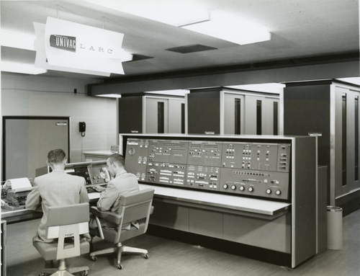
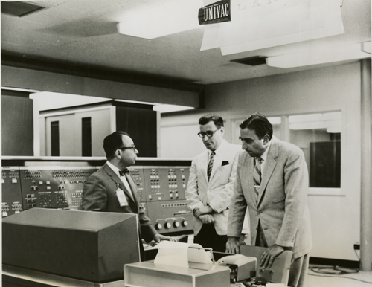
LARC at LLNL c1960
Fernbach, Harold Brown, EdwardTeller

Slide 13
Neil Lincoln’s Reminiscences of computer architecture and computer design at Control Data Corporation
NEIL: Compatibility doesn't concern me as much as the lack of communication. Again as an outsider looking at Univac Corporation, it just didn't make any sense … with the small amount of computer design talent that existed in the world in those days, with designers out there and designers here who refused to use each others circuits or even read each others papers or even talk to each other
…going back to the Univac 1, the early years at Univac with the 1101 and the 1103- I'm not even talking about the logic design or instruction set , but basic things like why not use the same size chassis?
Neil: I found out that the guys working on the LARC came from a BDP area, down in Philadelphia, and most of them …hadn't even the foggiest notion what an 1100 looked like and here they were building a scientific computer - the LARC. I feel that's why the LARC really died.

Slide 14
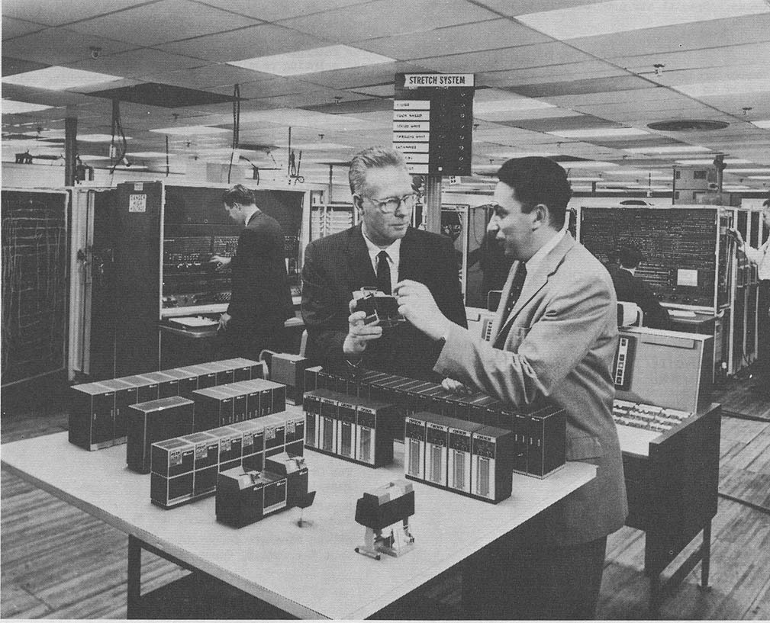
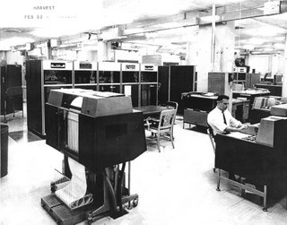
Mainframe? Supercomputer?: Stretch, Harvest
IBM 7950 (HARVEST)
Delivered to NSA 2/62
Was STRETCH + 4 boxes
  IBM 7951 Stream unit
  IBM 7952 Core storage
  IBM 7955 Tape unit
  IBM 7959 I/O Exchange
IBM 7030 (STRETCH)
Delivered to Los Alamos 4/61
Pioneered in both architecture
and implementation at IBM
Courtesy of Burton Smith, Microsoft

Slide 15
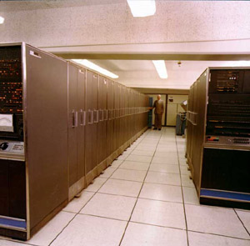
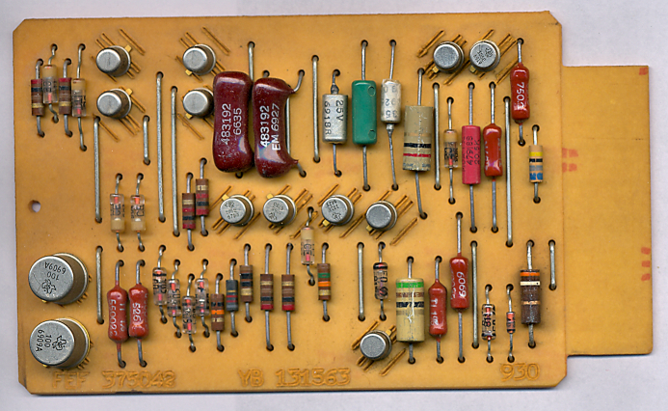
IBM SMS Modules for Stretch

Slide 16
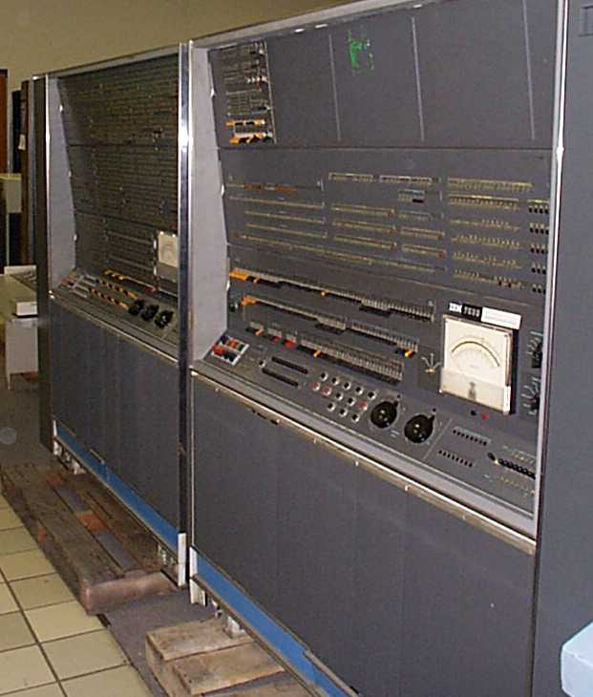
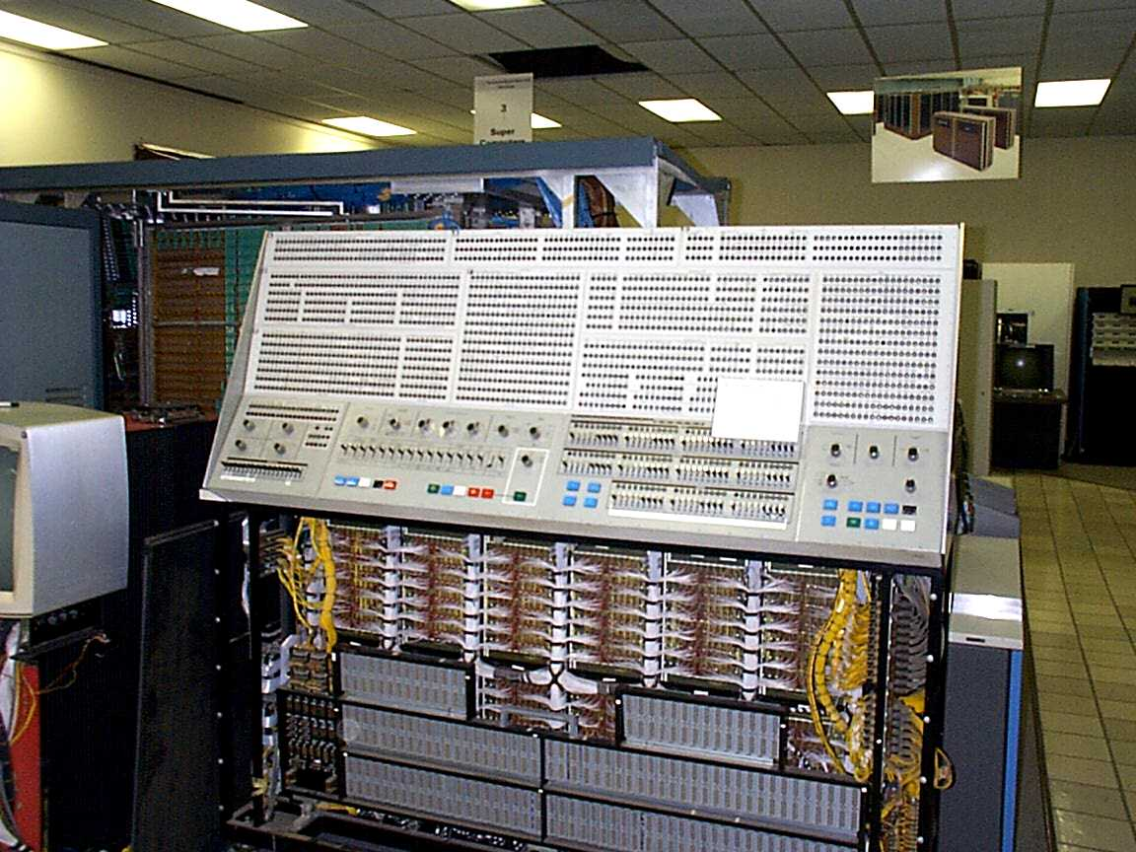
IBM Stretch c1961 & 360/91 c1965 consoles!

Slide 17
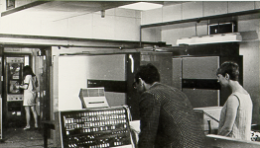
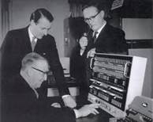
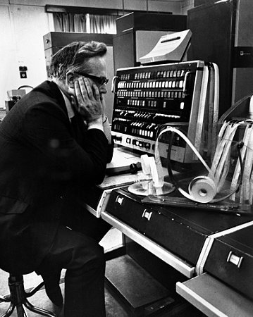
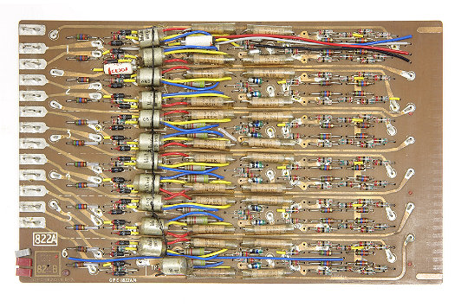
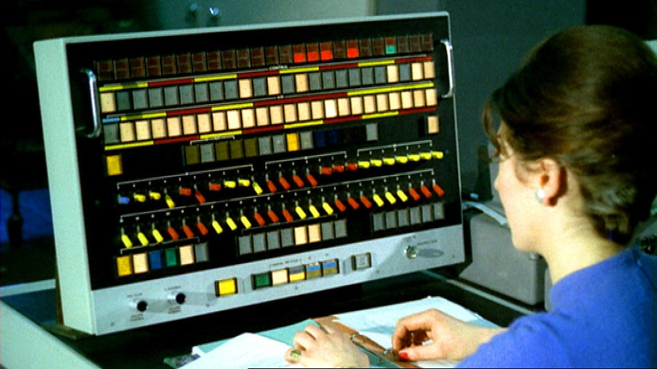
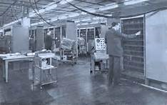
Ferranti/Manchester Atlas c1961
(One million instructions per second)
Mainframe? Supercomputer?

Slide 18
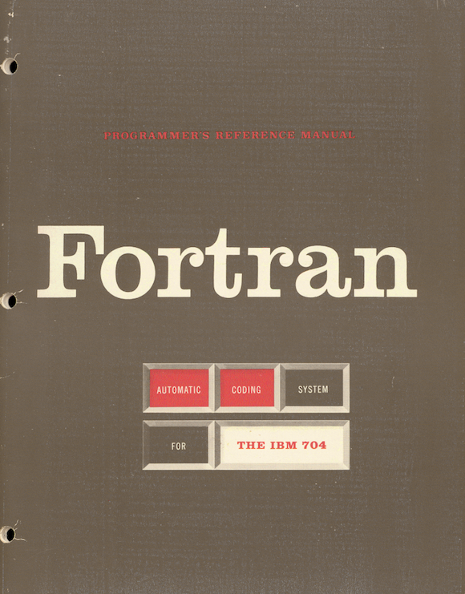
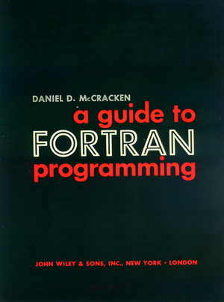
Fortran 1957, ’60, … ‘08

Slide 19
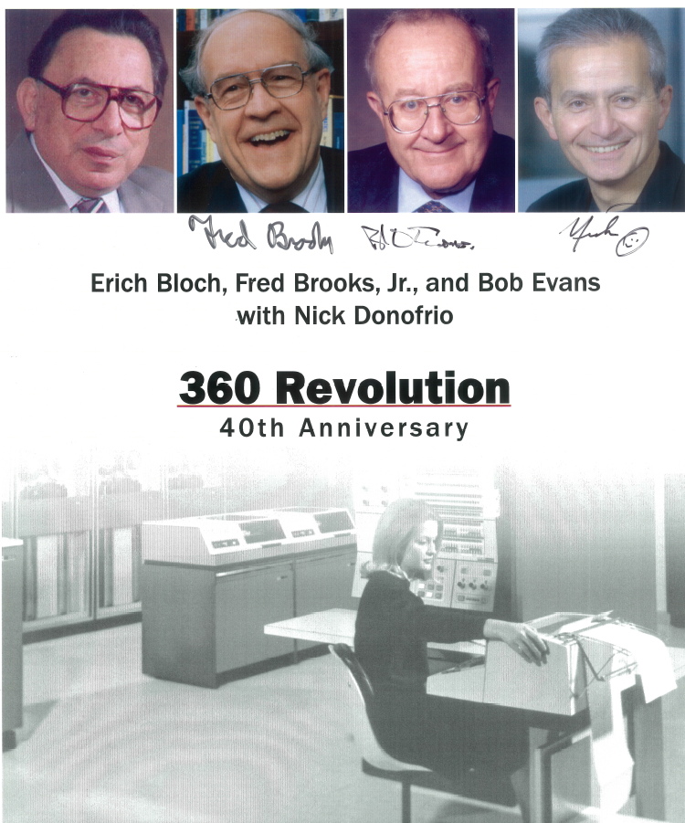
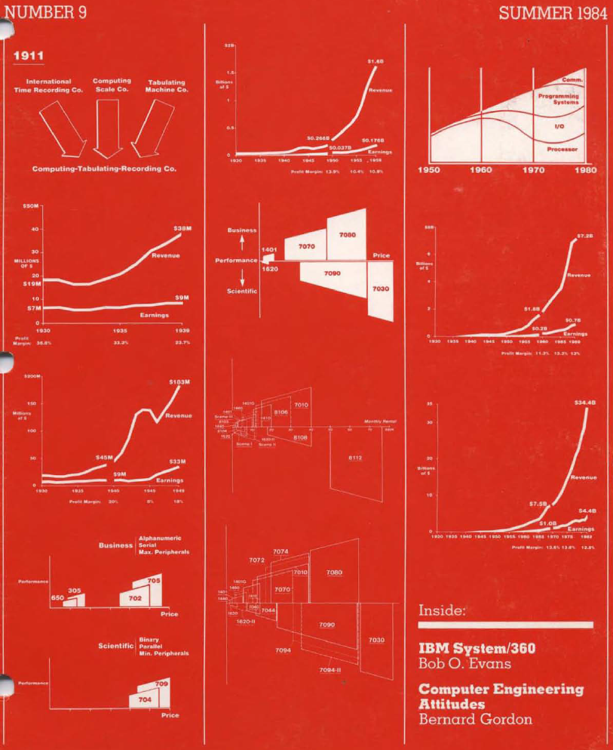
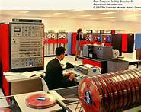
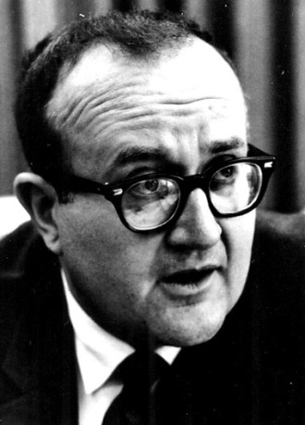
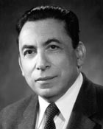
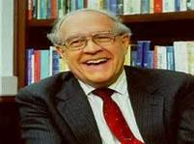
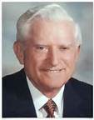
IBM System \360
April 6, 1964
Converging Calculation and
Record Keeping

Slide 20
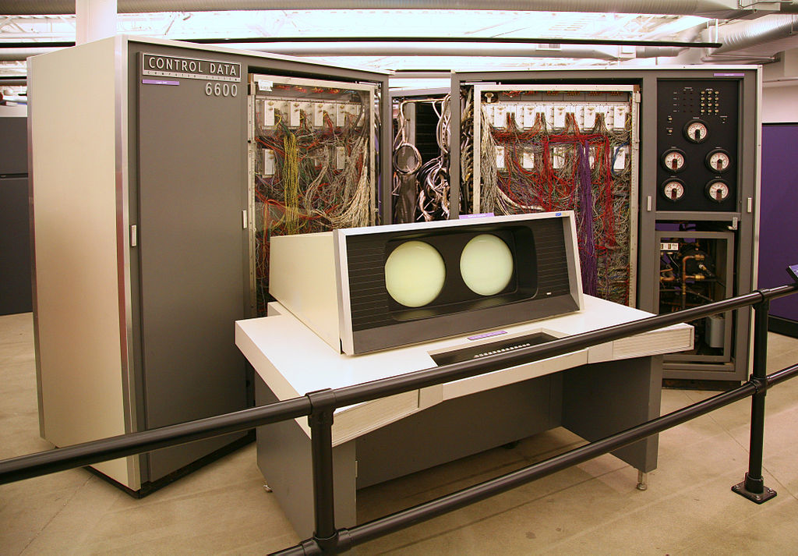
CDC 6600 #1 Console & frame c1964 LLNL
First Supercomputer?

Slide 21
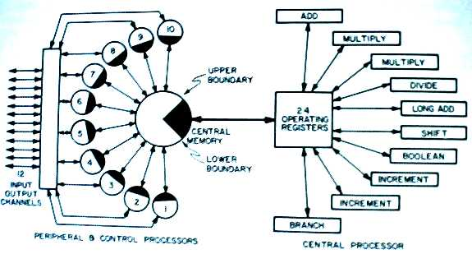
CDC 6600 block diagram
Notes:
The Thornton book is really great because it contains both the design philosophy and the design. It describes their quest for both speed through circuitry and parallelism. It is also a must read for every computer architect.
One principle was that all parts of the computer should operate asynchronously and independently. To begin with all IO devices could independently. Next any IO channel could be assigned to any IO device so that the channel doesn’t become a bottleneck. Finally, any IO Channel could be assigned to any of the ten IO Peripheral Processing Units or PPUs. PPUs were totally independent 12 bit computers similar to the CDC 160. All PPUs could transfer data to the central memory. There was unbound flexibility for the transfer of data into the large computer’s memory. Of course the central memory was accessed by the main processing unit where all the floating point computation was carried out on 60-bit words.

Slide 22
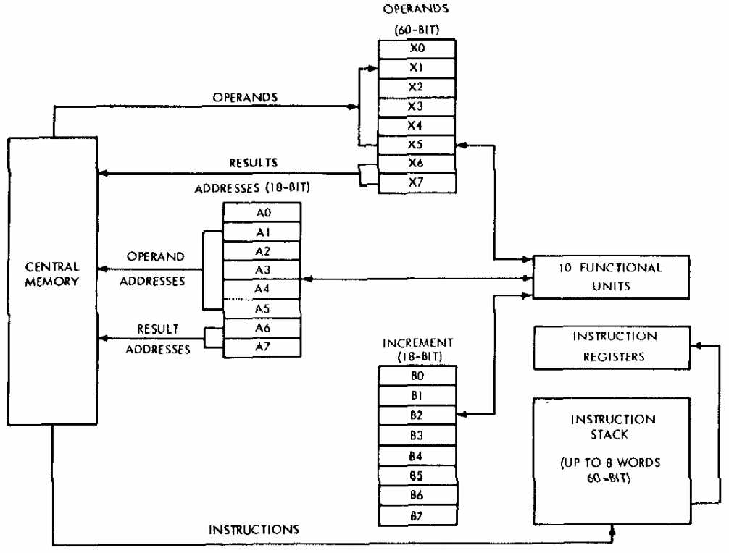
CDC 6600 registers
2¹⁷
60-bit words
400,000 transistors,
MTBF 2000 hrs.
Notes:
The processor state consisted of 3 groups of highly functional registers: of the eight 18-bit registers for memory access, 6 control loads, and 2 control stores to the corresponding eight 60-bit floating point registers; and there are eight 18-bit registers for integer and indexing operations. Operations could be carried out simultaneously on multiple registers in each group as long as there was no data interlock.
Data trunks carried information from registers to memory and to the functional units.
Of the functional units, 4 are for carrying out 60-bit floating point arithmetic among the 8 X registers. The other 6 carry out logic, indexing, and program control on the address, A and increment / index, B registers.
The control for managing the parallelism and interlocking was handled in two units called the stunt box and Scoreboard.
Instruction parallelism comes from an 8 word stack.

Slide 23
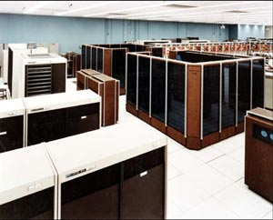
Two CDC 7600s and LLNL c1969
A Supercomputer?
Courtesy of Burton Smith, Microsoft

Slide 24
Neil Lincoln’s Reminiscences of computer architecture and computer design at Control Data Corporation
NEIL: Nevertheless, Seymour did have a conception of FORTRAN when he was building the 6600. He didn't build a machine and then adapt FORTRAN to it .
MARIS (re 7600): The really crucial thing was that Seymour was the key designer as well as the architect. He understood the whole thing and kept it under control.

Slide 25
Thought in 1964 when I heard about the 6600:
“Holy s**t!” How did they do that?
Digital’s PDP- 6 was being built and introduced
10x less expensive ($300 K vs. $3 M)
6600 had 600K transistors; 4 Phase, 10 Mhz clock
“6” processor: 2 bays x 10-5”crates x 25 = 500 modules, 5,000 transistors
  Clock ran asynchronously at 5 MHz.
  Successor PDP-10 ran at 10 MHz

Slide 26
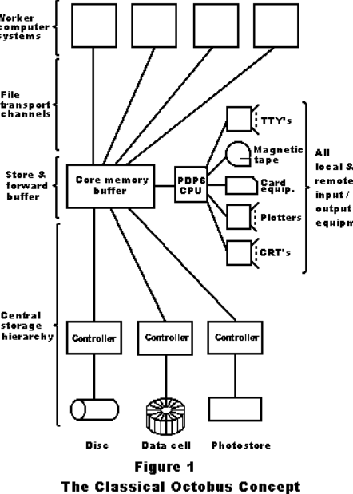
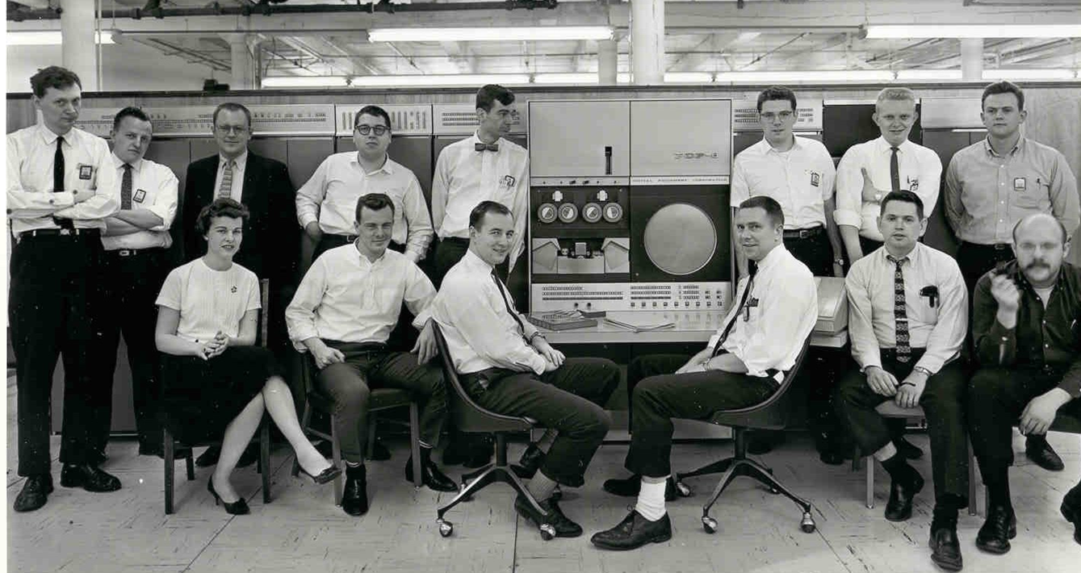
LLNL Octopus hub PDP-6 c1965
256Kword,
36 bits/word
2 x 10 x 25 =500 modules; 5000 transistors?1900 watts

Slide 27
PDP-6 …
 | 6 | 6600 | Factor
Transistor type Intro | Ge c10/64 | Si c9/64
No. transistors Not counting diodes | 500 boards x 10 Mem 50 x 10 | 400,000 | 400?
Clock (ns) | 200 | 4 phase, 100 | 2-4
Power watts | 1900 | 150,000 | 79x
Cost | 250-500K | 7-10 million | 14-20
Adams cost per month | 6.2-30 | 62-91 | 10
Adams add time | 4.4 | .3 | 14.7
Roberts cost $m | 1 | 5.5 | 5.5
Roberts perf. bits/us | 9 | 145 | 16
Roberts bits/sec/$ | 27 | 9 | 3
Degree of parallelism | 1, mem. overlap | Lots! happening…
Successors | DecSystem 10, 20 | 6400,…7600
Team size | 17 including SW | 35

Slide 28
Search for parallelism constrained by Amdahl’s Law
Three approaches… that didn’t work
Illiac IV (SIMD) m=64
CDC STAR and ETA10 vectors in memory
TI ASC (Vector arch; Cray 1’s 5x clock)
Then success
Cray 1 vector architecture

Slide 29
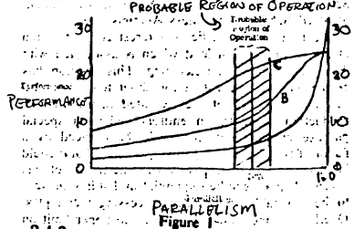
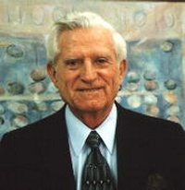
Amdahl’s law c1967…the limit of parallelism
If w₁ work is done at speed s₁ and w₂ at speed s₂,
the average speed s is (w₁+w₂)/(w₁/s₁ + w₂/s₂)
  This is just the total work divided by the total time
For example, if w₁= 9, w₂= 1, s₁= 100, and s₂= 1
then s = 10/1.09 ≅ 9 (speed)
  Amdahl, Gene M, “Validity of the single
  processor approach to achieving large
  scale computing capabilities”,
  Proc. SJCC, AFIPS Press, 1967
Courtesy of Burton Smith, Microsoft

Slide 30
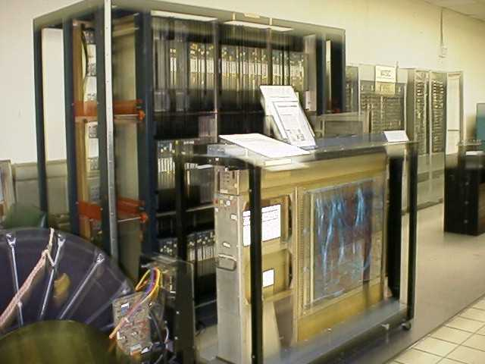
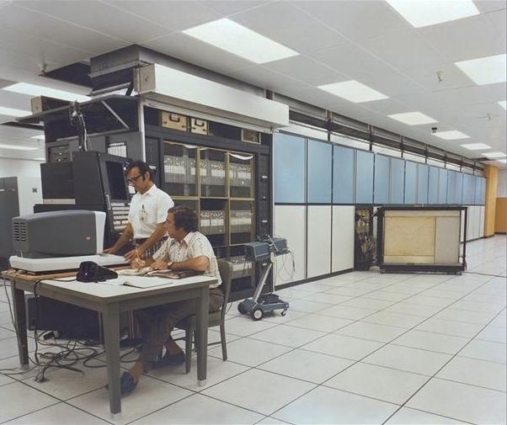
ILLIAC IV: Uof IL at NASA in1971
1964 project
(U. of IL)
Burroughs contract
SIMD 64 PEs
10 MB disk/PE
Moved to NASA
1975 on ARPAnet
Resides at the Computer History Museum
Courtesy of Burton Smith, Microsoft

Slide 31
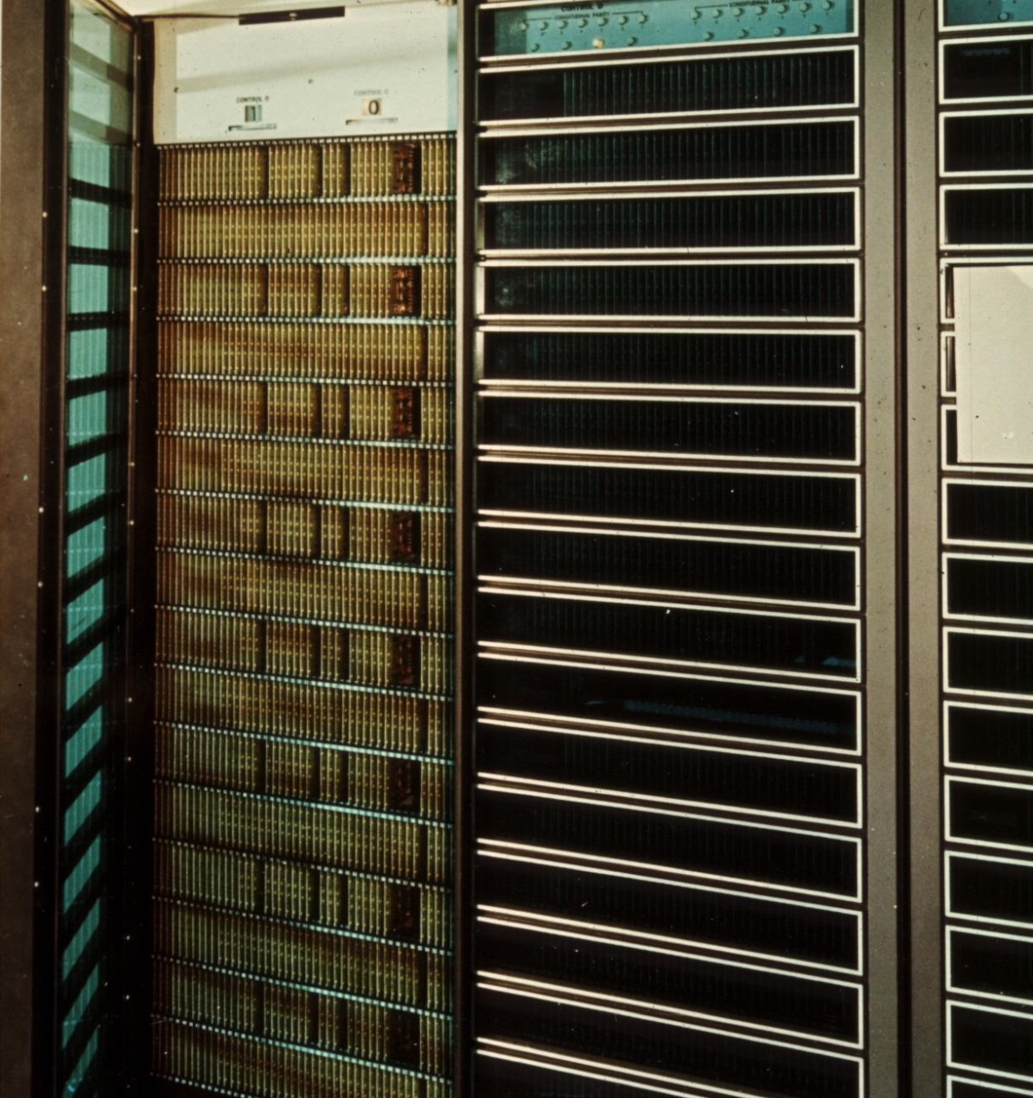
CDC STAR 100 at LLNL
CDC Star 100
Sept 74, 75
25 Mhz
50 Mflops
Mem-mem vectors
Cyber 203, 205
=>
ETA Systems (‘83-’89
CMOS
Liquid nitrogen
SMP 8 proc.

Slide 32
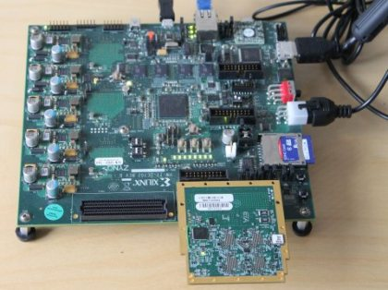
Parallela

Slide 33
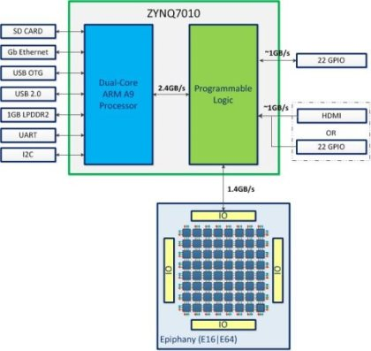
Adapteva: Parallella
(Kickstarter $s)
100 Gflops
800 Mhz; 2 Watts

Slide 34
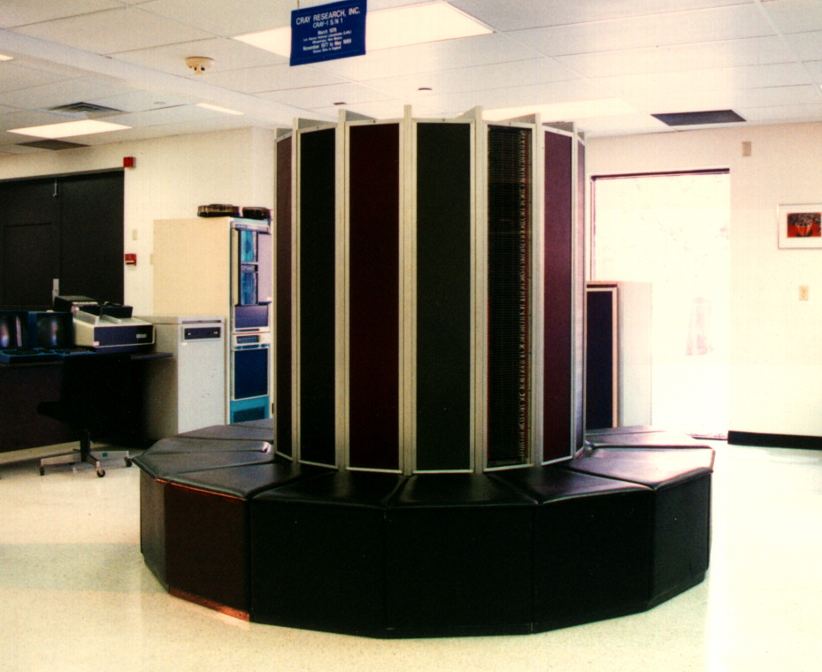
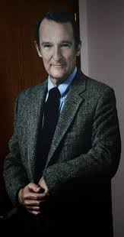
Cray-1 c1976: Supercomputer … vector era
Courtesy of Burton Smith, Microsoft

Slide 35
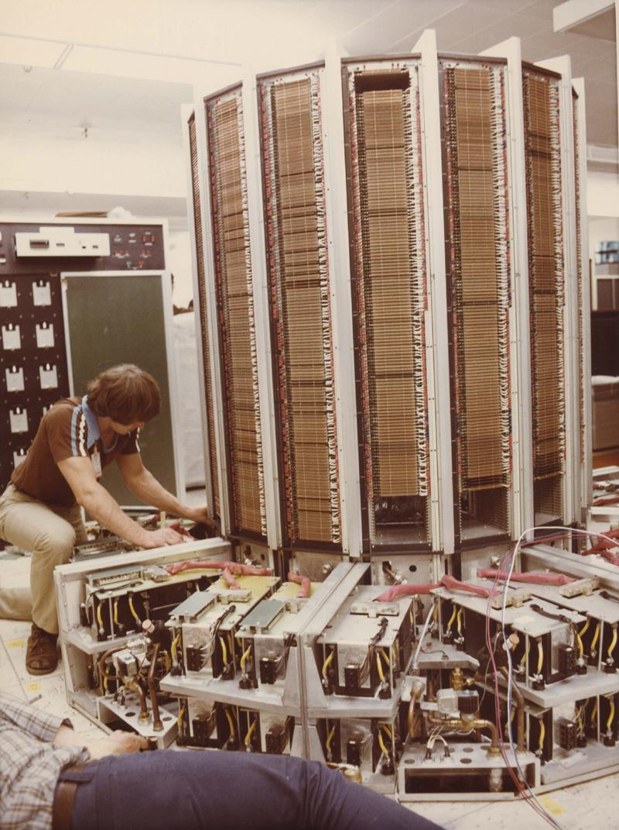
Cray 1 sans covers
The Vector ISA
Unlike the CDC Star-100, no development contract
Los Alamos got a one-year free trial. Los Alamos leased the system.
Los Alamos developed or adapted existing software
Cray-1 and Amdahl’s law
  Scalar performance
  2X the 7600
  Vector 160 Mflops
  80 MHz clock
Peak floating point ops vs. Instructions per second
“Supercomputer” connotes a Cray-1
Courtesy of Burton Smith, Microsoft

Slide 36
Cray 1 processor block diagram… see 6600
Notes:
Operations are carried out in the eight S scalar registers and 8 64-word Vector registers. Vector length is specified in a register and a mask determines which operands participate in a vector operation. Address arithmetic is carried out in the 8 A registers.
Two sets of 64 temporary registers store scalars and addresses to minimize access time.
Instructions are buffered in 4 groups of 64 x16 bits.
It is remarkably similar to the 6600… and extended for vectors.
In addition to operations that operate on fixed strides, a scatter-gather mode is used such that each operand is pointed to by an address.
This basic vector architecture has been implemented in numerous other architectures, including Japan and minisupercomputers. About a dozen manufacturers have copied the “Cray-style’ vector architecture.

Slide 37
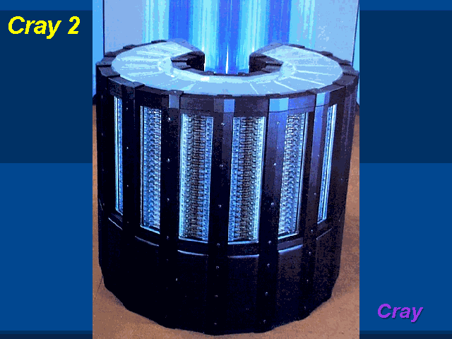
Shared Memory: Cray Vector Systems
Cray Research, by Seymour Cray
  Cray-1 (1976): 1 processor
  Cray-2 (1985): up to 4 processors*
Cray Research, not by Seymour Cray
  Cray X-MP (1982): up to 4 procs
  Cray Y-MP (1988): up to 8 procs
  Cray C90: (1991?): up to 16 procs
  Cray T90: (1994): up to 32 procs
  Cray X1: (2003): up to 8192 procs
Cray Computer, by Seymour Cray
  Cray-3 (1993): up to 16 procs
  Cray-4 (unfinished): up to 64 procs
All are UMA systems except the X1, which is NUMA
  *One 8-processor Cray-2 was built
Cray-2
Courtesy of Burton Smith, Microsoft

Slide 38
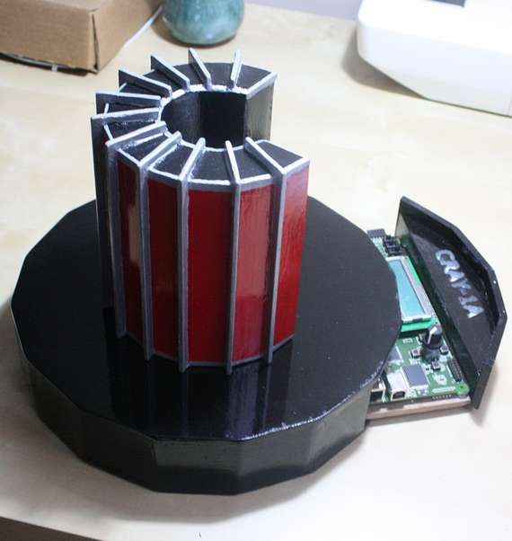
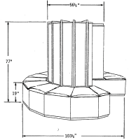
Fenton-Tantos
Desktop Cray 1 or XMP at 0.1 size.
Spartan-3E-1600-Development-Board

Slide 39
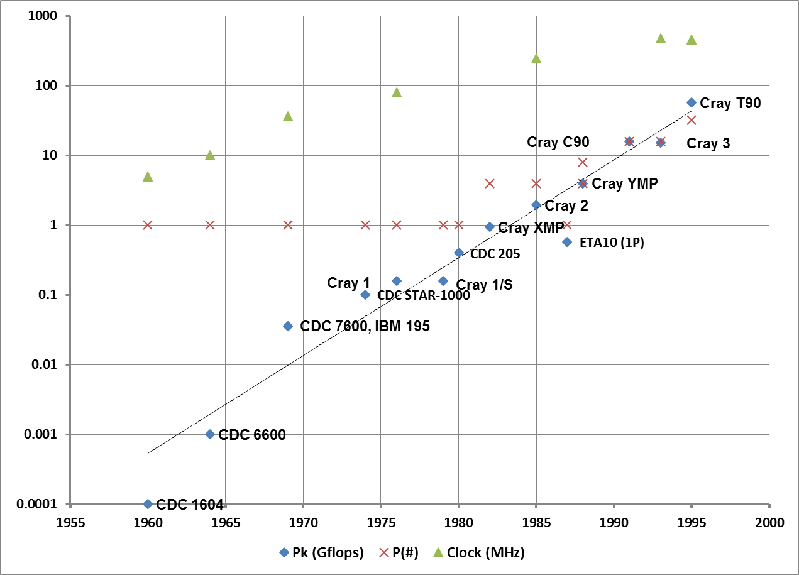
Cray Era Computers: 1964-1994

Slide 40
Capability versus Capacity
Capability: ability to finish a job in shortest time i.e. speed
Capacity: ability to finish a workload of jobs
Super-minicomputers, Mini-supercomputers and
Personal-supercomputers
  CIost, capacity, and control

Slide 41
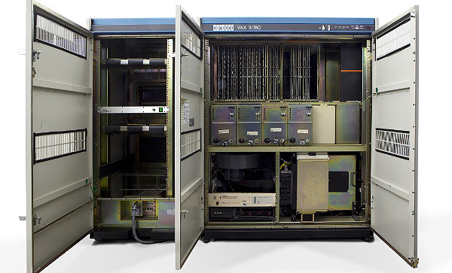
VAX-11/780 c1977
32 bit super minicomputer
32 bit word. VM
VAX = virtual address extension
$250,000
1-2 Mbytes
Serial 3? delivered to CMU’s John Pople for Computational Chemistry
As a PC.

Slide 42
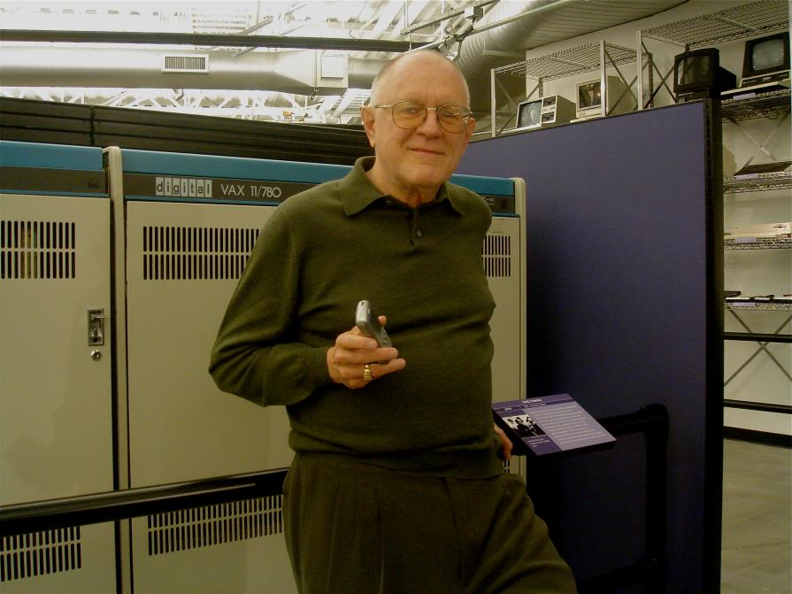
VAXen (1977) a super-minicomputer became a “personal supercomputer”
Linpack (Mflops):
VAX 11/780 0.14
Cray 1 26
Clock (MHz)
VAX 5
Cray 1 80

Slide 43
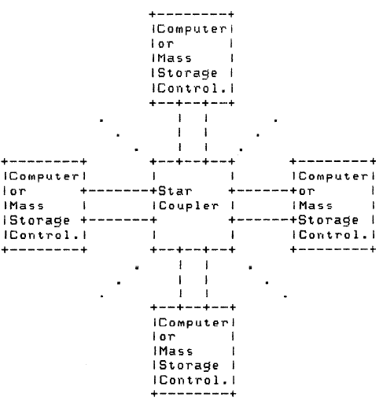
VAX Strategy 1979 … VMS Clusters 1984 big computers = interconnected minicomputers
CI (Computer Interconnect)
Two links at 70 Mbps
Eventually Ethernet

Slide 44
1982-1984 : The Lax Report to NSF’s NSB for NSF Advanced Scientific Computing
Gresham's Law: VAXen are driving out supercomputers
NSF needs to fund supercomputer access and centers
1984: NSF Establishes Office of Scientific Computing
  NCSA at U IL (1985)
  SDSC at UCSF
  Cornell National Supercomputer Facilility
  Pittsburgh Supercomputer Center
  John Von Neumann Center at Princeton etc.

Slide 45
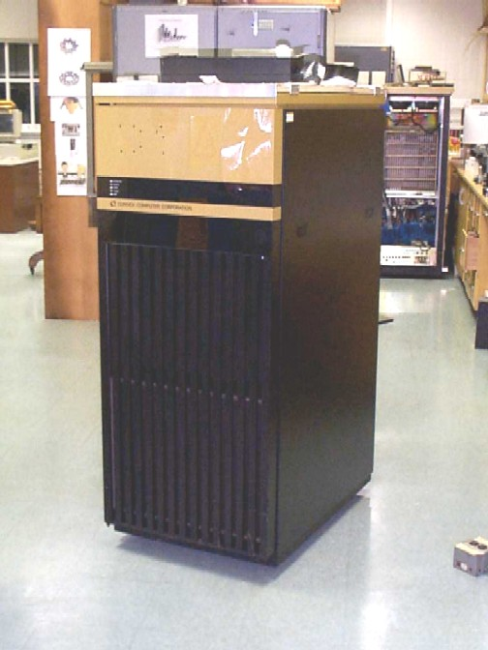


Trickle Down: mini-supercomputers c1985
Mini-supercomputers (Convex and Alliant)
Personal supercomputers (Ardent)
Convex C-1, 1985; C-2 mP 1988

Slide 46



Ardent Titan
Graphics Personal Supercomputer

Slide 47


1987: The personal graphics supercomputer
Linpack (Mflops):
Ardent (4) 24
Cray 1 26
Clock (MHz)
Ardent 32
Cray 1 80
Cost $120,000
PSC was offered 135 at $10 M.

Slide 48
Search for the next supercomputer: the 1983-1993 transition to multicomputers
Break from single memory computers
Factors that enabled the transition
  Japanese 5th Generation (AI) threat
  DARPA Response stimulates many startups
  Powerful inexpensive CMOS micros cross-over
  performance of TTL and ECL proprietary processors
  Clustered micros declared mono-memory alternative
  Incentive & Measurement: Bell Prize ‘87, Top500 ‘93
  Existence proof that “they work”
  Standards to build i.e. Beowulf and program i.e. MPI
  “Grand challenge” problems to justify funding for NBC

Slide 49



1982 The Japanese are Coming!

Slide 50

Threat Response:
Kickoff of DARPA’s SCI program c1984…
Steve Squires, DARPA &
Gordon Bell, Encore seated at our “Cray”.
10+ years later:
“Killer micros” Clusters become standard

Slide 51

Moore’s Law generated more powerful computers: 4>8>16>32>64> n64-bit computers per die

Slide 52

TTL & ECL to
CMOS transition…
Enter the “Killer Micro”!
Death of vanity minicomputers and workstations

Slide 53



1983 Caltech Cosmic Cube
8 node prototype (‘82) & 64 node ‘83
Intel iPSC 64 Personal Supercomputer ‘85

Slide 54
Amdahl’s law… the limit of parallelism
If w₁ work is done at speed s₁ and w₂ at speed s₂,
the average speed s is (w₁+w₂)/(w₁/s₁ + w₂/s₂)
  This is just the total work divided by the total time
For example, if w₁= 9, w₂= 1, s₁= 100, and s₂= 1
then s = 10/1.09 ≅ 9 (speed)
  Amdahl, Gene M, “Validity of the single
  processor approach to achieving large
  scale computing capabilities”,
  Proc. SJCC, AFIPS Press, 1967
Courtesy of Burton Smith, Microsoft

Slide 55

Bell Prize for Parallelism, July 1987
Alan Karp:
Offers $100 for a program with 200 X parallelism by 1995.
Bell, 1987 goals:
10 X by 1992
100 X by 1997
Researcher claims:
1 million X by 2002

Slide 56


Slide 57

Gustafson’s Law
Benner, Gustafson, Montry winners of first Gordon Bell Prize
S(P) = P –α x (P-1)
P is the number of processors,
S is the SPEEDUP, and
α, the non-parallelizable fraction of any parallel process

Slide 58
1989: The “killer micros” –Eugene Brooks, LLNL
Challenge: how do you utilize (program)
a large number of interconnected,
independent computers?

Slide 59


By 1996 supercomputing will be done predominately with >1000 processors
–D. Hillis, 1991
Not so grand challenge

Slide 60
Grand Challenge problems c1992

Slide 61
1994: Computers will All be Scalable
Thesis: SNAP: Scalable Networks as Platforms
  upsize from desktop to world-scale computer
  based on a few standard components
Because:
  Moore’s law: exponential progress
  standards & commodities
  stratification and competition
When: Sooner than you think!
  massive standardization gives massive use
  economic forces are enormous

Slide 62

Top500.org Linpack Ranking 1993

Slide 63

Top500 #1 @ 60 Gflops: June 1993

Slide 64


1994: MPI 1.0 Massage Passing Interface

Slide 65


Beowulf:
Computer Cluster by Don Becker & Tom Sterling, NASA 1994
BSD, LINUX, Solaris, and Windows Support for MPI and PVM

Slide 66


Lost: The search for parallelism c1983-1997
DOE and DARPA Adv. Sci Comp. Initiative
ACRI French-Italian program
Alliant Proprietary Crayette
American Supercomputer
Ametek
Applied Dynamics
Astronautics
BBN
CDC >ETA ECL transition
Cogent
Convex > HP
Cray Computer > SRC GaAs flaw
Cray Research > SGI > Cray Manage
Culler-Harris
Culler Scientific Vapor…
Cydrome VLIW
Dana/Ardent/Stellar/Stardent
Denelcor
Encore
Elexsi
ETA Systems aka CDC;Amdahl flaw
Evans and Sutherland Computer
Exa
Flexible
Floating Point Systems SUN savior
Galaxy YH-1
Goodyear Aerospace MPP SIMD
Gould NPL
Guiltech
Intel Scientific Computers
International Parallel Machines
Kendall Square Research
Key Computer Laboratories searching again
MasPar
Meiko
Multiflow
Myrias
Numerix
Pixar
Parsytec
nCUBE
Prisma
Pyramid Early RISC
Ridge
Saxpy
Scientific Computer Systems (SCS)
Soviet Supercomputers
Supertek
Supercomputer Systems
Suprenum
Tera > Cray Company
Thinking Machines
Vitesse Electronics
Wavetracer SIMD
RIP

Slide 67

ASCI: Accelerated Strategic Computing Initiative
=>ASC: Advanced Simulation and Computing from Alex R. Larzelere II, History of ASCI, 1995-2005

Slide 68

ASCI Red 1997-2005 at Sandia National Lab
June 1997-2000
1.3-2.5 Tflops
9,216-9632 proc
640 disks,
1,540 PS,
616 interconnect

Slide 69

Japanese Earth Simulator (NEC)
2002-2004 35 Teraflops 5,000 vector processors
…Stimulant for ASCI

Slide 70

IBM BlueGene/L Nov 2004-2007 at LLNL: 212Kcores, 600 Tflops

Slide 71
 | Cray | IBM | Fujitsu
Highest in | 2012 Nov | 2012 June | 2011 June
Power (Mwatts) | 8.2 | 7.9 | 12.6
Space Sq. meters | 404 | 280
Memory (Pbytes) | 0.6+0.1 | 1.6 PB
Storage | 10 PB, 240 GB/s IO^{[2]}
Speed (Pflops) | 17.59 | 16.32 | 10.51
Cost | $97 M
Cabinets|Racks | 200 | 96 | 864
Blades/cab|Cnode(aka chip)/rack | 24 | 1024 | 102
Nodes/blade|Core/Cnode | 4 | 16 | 8
Cores/Node(aka chip)|Cnode/chip | 16 | 1 | -
Mp/node|Mp/Cnode | 32 | 16 | 16
TF/cabinet|TF/rack | 100 | 209
KW/rack | 41 | 80
Processor Total | 307,200 | 1,572,864 | 705,024
Mp (TB) | 614.4 | 1,573 | 1,410
Nvidias PE total | 51,609,600 Mp 100 TB

Slide 72
Three top500 2011-2014
June 2011 Fujitsu Riken Multicore, Vector processor
June 2012 LLNL Sequoia Quad-threaded processor
Nov 2012 ORNL Titan 16 core – GPU (2.5K core)
June 2013 Tiahne 2 2 x 12 core + 3 x 57core

Slide 73



Fujitsu K Riken Computer c1/2012
((4 proc.-chips x
24 boards) + 6i/o
X 864 cabs
= 88,128 @2GHz
x 8 cores per chip
= 705,024 proc.
Mp(1.4 PB;
2 GB/core)

Slide 74

LLNL Sequoia 17 Petaflops… Tops500 #1 June 2012
4 threads/core
16 cores/chip
1024 chips/rack
96 racks per system
1.57 million processors
1 GigaBytes/processor
1.6 PetaBytes primary memory
80 KWatt/rack
7.7 MWatts

Slide 75

ORNL Titan Cray Supercomputer
18,688 AMD 16-core Opteron 6274 CPUs = 299K nodes@2.2 GHz
  200 cabinets x 4 nodes/blade x 24 blades/cabinet x 16 cores/node = 299K core
  Pc: 18.7K proc x 16 core/proc. x 2.2 GHz. = 658 Tticks; ?? Flops/tick
  Mp: 200 x 96 nodes/cab x 32 GB/node = 600 TB
18,688 Nvidia 2.5K-core K20 GPUs. 732 MHz = 46.5 M cores
  1.3 TFlops per chip??
  Mp: 112 TB; 6 GB/proc? …1/40 of a byte per FLOP on GPU
Ms: 13.6 PB driven by 140-Dell servers
9 Mwatts; PUE=?? 404 m²
1-5 weather years per day of simulation

Slide 76


Tianh-2: Top500, June 2013-present
54.9 PAP petaflops; 1.4 Pbytes, 17.6 MWatt
32K Ivy x 12 core + 48K Xenon x 57 core = 3,120K cores.
2 nodes/board x 16 board/frame x
4 frames/rack x 125 racks =
16,000 boards
2 Ivy + 3 Xenon /board

Slide 77
Three top500 2011-2014
June 2011 Fujitsu Riken Multicore, Vector processor
June 2012 LLNL Sequoia Quad-threaded processor
Nov 2012 ORNL Titan 16 core – GPU (2.5K core)
June 2013 Tiahne 2 2 x 12 core + 3 x 57core

Slide 78
2015: 100 petaflops; 2018: 1 exaflops
NUDT (China) Tianhe-2
  100 petaflops supercomputer for completion in 2015.
  1 exaflop supercomputer online by 2018 using the Intel MIC multi-core processor architecture
Given the current speed of progress … supercomputers will reach one exaflops (10¹⁸) (one quintillion FLOPS) by 2018-20.
SGI plans to achieve a 500 fold increase in performance by 2018, and achieve one exaflops.

Slide 79
Challenge i.e. change in HPC to come
20 years of stability since 1994…10^{p} p= 3,…6, … 9?
Jan. 2007 Jim Gray posits Fourth Paradigm of Science
  Analysis of experimental data by computer to “do science”
  Analysis of data coming from models (3rd Paradigm data)
Merger of data science and computational science architectures at machine and application program
Cloud service evolves to support HPC…
  Cloud provides HPC and database services… architecture and application

Slide 80
The End

Slide 81

Result: The End of Historic Scaling
C Moore, Data Processing in ExaScale-ClassComputer Systems, Salishan, April 2011
Notes:
The mining out of ILP

Slide 82
Top 500 1993-2013
NUDT Tiahne-2 China, June 2013 -
Cray Titan US, November 2012
IBM Sequoia Blue Gene/Q US, June 2012 – November 2012
Fujitsu K computer Japan, June 2011 – June 2012
NUDT Tianhe-1A China, November 2010 – June 2011
Cray Jaguar US, November 2009 – November 2010
IBM Roadrunner US, June 2008 – November 2009
IBM Blue Gene/L US, November 2004 – June 2008
NEC Earth Simulator v Japan, June 2002 – November 2004
IBM ASCI White US, November 2000 – June 2002
Intel ASCI Red US, June 1997 – November 2000
Hitachi CP-PACS v Japan, November 1996 – June 1997
Hitachi SR2201 v Japan, June 1996 – November 1996
Fujitsu Numerical Wind Tunnel v Japan, November 1994 – June 1996
Intel Paragon XP/S140 US, June 1994 – November 1994
Fujitsu Numerical Wind Tunnel v Japan, November 1993 – June 1994
TMC CM-5 US, June 1993 – November 1993
Intel Touchstone Delta

Slide 83

Top500: Rmax, Cores, Kwatts

Slide 84

HPC and Clouds:
Twins Separated At Birth
Numbers versus Records
A few users, large problems (floating-point numbers)
  Versus
Millions of users (data)
Similar technology issues
  Node and system architectures
  Communication fabrics
  Storage systems and analytics
  Physical plant and operations
  Programming models
  Reliability and resilience
Differing culture and sociology
  Design and operations
  Management and philosophy
Courtesy Dan Reed, Microsoft

Slide 85


Traditional Datacenter Builds
Monolithic design & construction | Typical large datacenter = 11 football fields 20 to 50 Megawatts
Huge $$$ | Typical construction costs = $10M to $20M per Megawatt
Long lead time | 18 to 24 months from design to online

Slide 86
The end

Slide 87
Computer ops/sec x word length / $

Slide 88
HPC and Clouds:
Twins Separated At Birth
Numbers versus Records
A few users, large problems (floating-point numbers)
  Versus
Millions of users (data)
Similar technology issues
  Node and system architectures
  Communication fabrics
  Storage systems and analytics
  Physical plant and operations
  Programming models
  Reliability and resilience
Differing culture and sociology
  Design and operations
  Management and philosophy
Courtesy Dan Reed, Microsoft

Slide 89
Technical (HPC) vs. Commercial (Cloud)
1 (few) users, n x faster
Mega-flops… Exa-flops
programmer parallelism
answer to problem: design, simulate,analyze
large model, long comp.
app tuned to solve prob.
apps last a few years
one user, batch
min(time for an answer)
N – users
Mega-bytes… Exa-bytes
I/O; network bandwidth
embarrassingly parallel
bus critical - query & TP: OLTP, decision support,
persistent data
exchange information
apps last many years
multiple users, interactive
min (time for all user queries)
continuous availability
Darema & Parr, IBM Research Center

Slide 90
HPC & Cloud: Twins, Separated at Birth
(Computation versus Storage Centric)
HPC: Separate Storage Area Network, two switches
(P-Mp) Ms
S … S …
(P-Mp) Ms
Cloud: Attached Storage, single switch
P-Mp
Ms S
…

Slide 91


Slide 92
Traditional Datacenter Builds
Monolithic design & construction | Typical large datacenter = 11 football fields 20 to 50 Megawatts
Huge $$$ | Typical construction costs = $10M to $20M per Megawatt
Long lead time | 18 to 24 months from design to online

Slide 93

Microsoft Data Center Scale

Slide 94

2.1 Mwatt Wind turbines, South Australia
4 to power Sequoia; 8 to power Tianhe-2
10-20 to power an Amazon, Google, Microsoft data center

