Slide 1
Task Completion Detection
A Study in the Context of Intelligent Systems
Ryen W. White, Ahmed Hassan Awadallah, Robert Sim
Microsoft Research

Slide 2
Challenges in Task Management
Intelligent systems (digital assistants, etc.) store / remind users about tasks
Tasks can be explicitly specified or inferred (e.g., from email)
Users face least two challenges:
Task lists grow over time making it difficult to focus attention on pending tasks
By ignoring task status, systems can remind users about completed tasks
Methods to more intelligently flag completed tasks are required

Slide 3
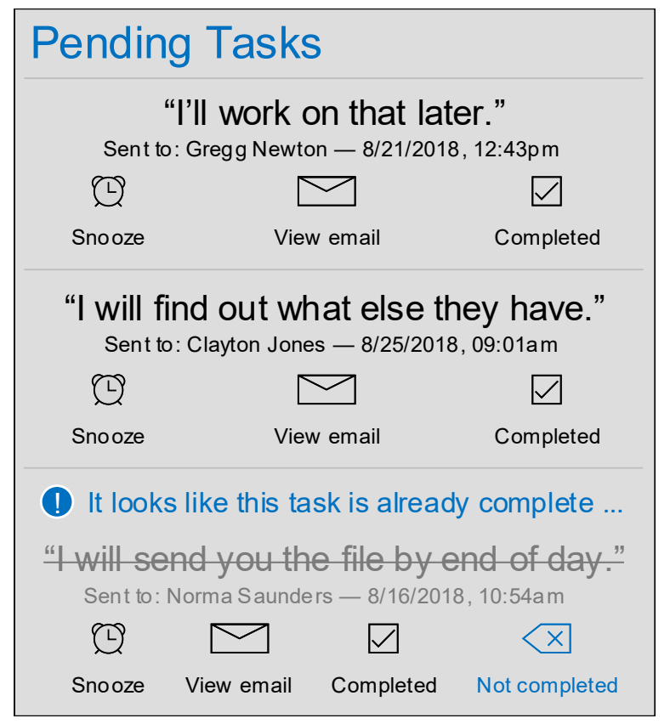
Example Scenario: Task Auto-Deprecation
Show pending tasks (e.g., commitments)
Flag or deprecate completion candidates
Provide recourse links to undo
Other applications possible, incl. task ranking, task prioritization, etc.
Focus on reminder/notification suppression

Slide 4
This Study
Introduce task completion detection as an important new ML challenge
Analyze data from popular digital assistant (Microsoft Cortana)
Reveal trends in temporal dynamics of completion per task attributes
Train ML classifiers to detect task completion
Use many signals, including time elapsed, context, task characteristics
Present design implications for intelligent systems from being able to automatically detect task completion

Slide 5
Commitments Data
1.2M consenting users of Microsoft Cortana in en-US
Cortana tracks commitments made by users in outgoing email, e.g.,
“I will send you the report”
“I’ll get back to you by EOD”
“I’ll work on it this evening”
“Will get back to you next week”
3M commitments collected during 2017-18 (avg. ~2.3 per user)
Commitments persist in system for max 14 days (our focus here)
= Tasks in our study

Slide 6
Commitment Meta-Data
E.g., due dates (“I’ll get this to you by next Friday”)
Extracted from commitment text using proprietary methods
Statistics:
24% of commitments have a due date
Due dates fall within avg 1.78 days of commitment (stddev 3.62, med 0.71)
Most commitments (86.3%) are made on weekdays
Presence of intervening weekend days increases time until due date

Slide 7
Labeling Methodology (1 of 2)
Use Cortana commitments usage data to compute completion labels
Cortana has a feedback affordance for users to indicate task completion
“Complete” clicks help form ground truth
Only says task was completed BY some time, not WHEN the task completion occurred
OUR GOAL: Only remind/notify users for tasks that are not yet completed

Slide 8
Labeling Methodology (2 of 2)
For each of 3M commitment tasks:
Label distribution: 1.53M positive (51%) and 1.47M negative (49%)
Task completion is time dependent (i.e., more tasks get done over time)
GOAL: Only remind/notify users for tasks that are not yet completed
i.e., not complete by t_{n}
Random delay (d, 1-14 days)
Time
t_{i}
Click “Complete”
before t_{n}
(Positive)
t_{n}
Not click “Complete” before t_{n}
(Negative)
Commitment made
Candidate
notification
time

Slide 9
Temporal Dynamics

Slide 10
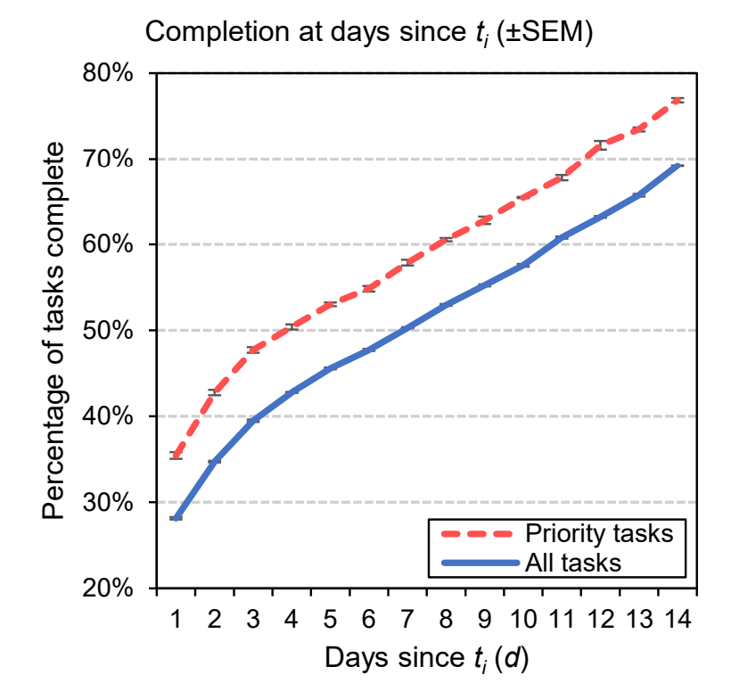
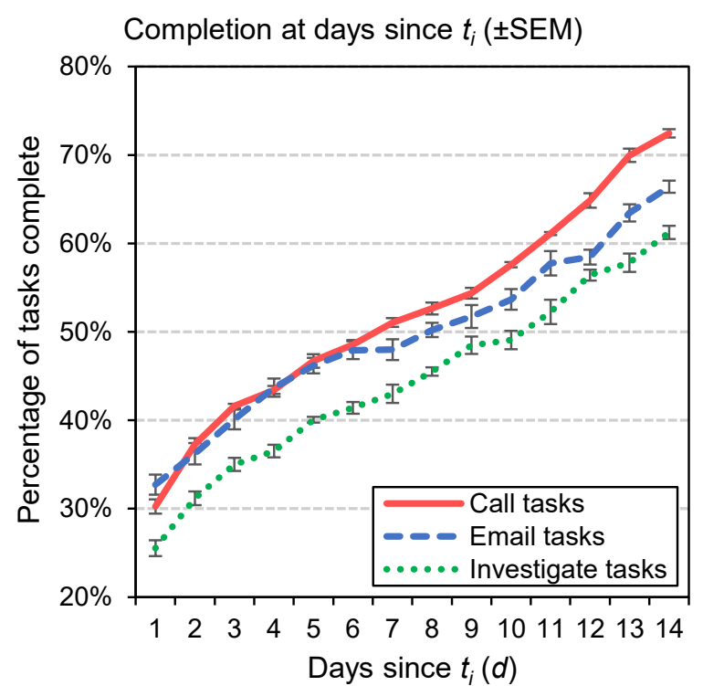
Task Completion Over Time
Compute fraction of tasks completed at t_{n}, all tasks and per task type
Task type by priority (high-pri language) and by activity (call, email, investigate)
Some email tasks can be handled as quickly as a phone call
High priority tasks are completed faster
Relative completion timing: Call < Email < Investigate Connected to avg relative complexity

Slide 11
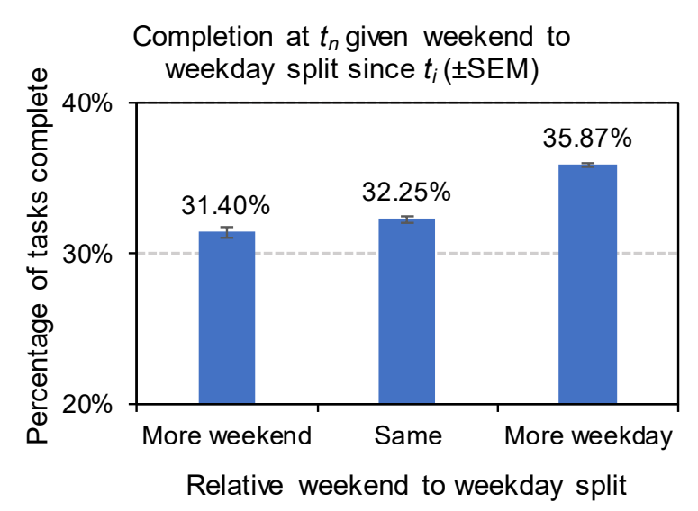
Weekend vs. Weekday
Studied differences in number of weekend days and weekdays between commitment made (t_{i}) and notification time (t_{n})
Focus on d=2 to control for confounds
Three groups:
More weekend (2 weekend, 0 weekday)
Same (1 weekend, 1 weekday)
More weekday (0 weekend, 2 weekday)
Task completion % higher when there are more weekdays

Slide 12
Detecting Task Completion

Slide 13
Methods
Train binary classifiers to detect completion of pending task by notification time (t_{n}) using many signals
Use completion labels from “Complete” clicks as ground truth
Five feature classes:
Time: time elapsed since task created, #weekend days, #weekdays
Commitment: n-grams, verbs, priority, due date, is conditional, intent, etc.
Email: subject n-grams (no email body), is reply, number of recipients, etc.
Notifications: logged Cortana notifications (16% of tasks), num notifications, etc.
User: >1 commitments (38% of users), historic tasks, completion time/rates, etc.

Slide 14
Learning Algorithms
Logistic Regression
+ Compact, interpretable models
+ Used previously for task modeling on email*
Gradient Boosting Decision Trees
+ Efficiency, accuracy, robustness to missing/noisy data, interpretability
+ LightGBM (used here) optimized for speed and low memory consumption
Neural Networks – bi-directional RNN with GRU and attention
+ State-of-the-art NLU performance
* Corston-Oliver, S., Ringger, E., Gamon, M., & Campbell, R. (2004). Task-focused summarization of email. In Text Summarization Branches Out (pp. 43-50).

Slide 15
Evaluation
Split 3M commitments into training (2.9M), validation (50k), testing (50k)
Stratified commitments by user (user only in one of train/valid/test)
Tuned model hyperparameters on validation set
Computed accuracy, F1, precision-recall
Sig: Two-tailed t-tests with bootstrap sampling (n=10)

Slide 16
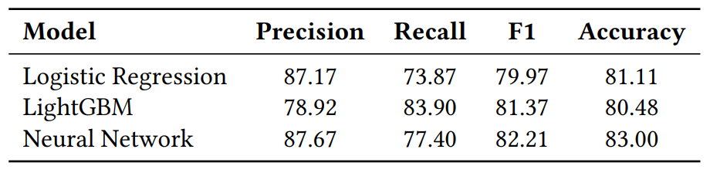
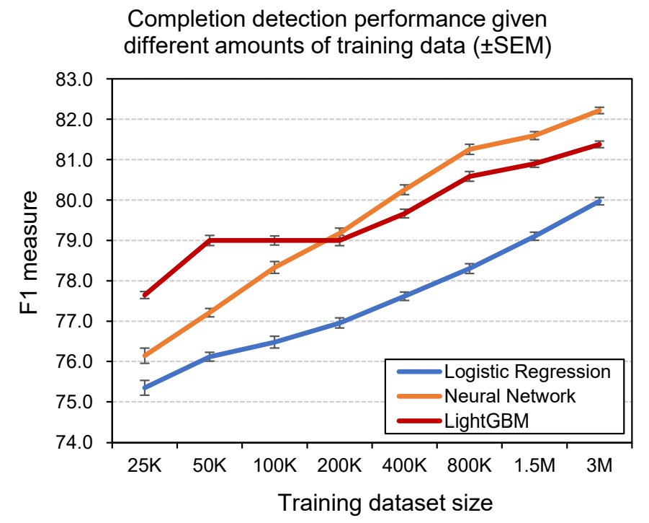
Findings
Overall model performance
All paired differences in F1 significant at p <.01
Overall
LR model performs worst
LightGBM and NN perform similarly
LightGBM simpler, more interpretable, faster to train
NN can better encode text (not needed)
Effect of data volume
Vary training set from 25K to 3M
LR model performs worst at all data points
LightGBM and NN outperform LR
LightGBM better for less data (≤100K)
NN better for more data (≥200K)

Slide 17
Findings
Removing one feature class at a time
Note: Differences in F1 vs. All Features significant at * p <.05 and ** p < .01
Effect of features used
Used LightGBM (faster, etc.)
Two complementary strategies
Dropped feature classes, one-by-one
Trained on one feature class at a time
Ablation Findings
Removing Time/Email/Notification has little effect
Substitutable with other features (notifications)
Removing Commitment Text has little effect
Features captured elsewhere (verbs, etc.)
One-Class Findings:
Commitment features most important
User features are also strong
Personalization or user segmentation (?)
Training on one class at a time
Note: Differences in F1 vs. All Features significant at * p <.05 and ** p < .01

Slide 18
Discussion
“Auto-deprecation” experience from Slide 3
Accurately detect completion, although focused on one (notifications) scenario
Need to understand how users respond
Incl. UX designed to help not hinder users
Measured independently, on all users
Likely used in a pipeline, on user segments
Task progression is important
More general problem than task completion

Slide 19
Summary and Takeaways
Detecting task completion important challenge in intelligent systems
Help users focus on what needs their attention (vs. what has been done)
Showed strong performance (~83%) for one scenario (notifications)
Need to explore more sophisticated ML, richer signal collection, expand to other scenarios and task types, etc.
Need to work with users to understand the impact of completion detection
Esp. when the experience is visibly altered by the task completion inference

