Slide 1
Search Interaction
Challenges and Opportunities
Ryen White
Microsoft
ryenw@microsoft.com
ryenwhite.com

Slide 2
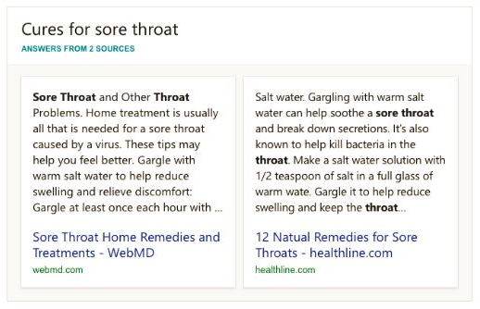
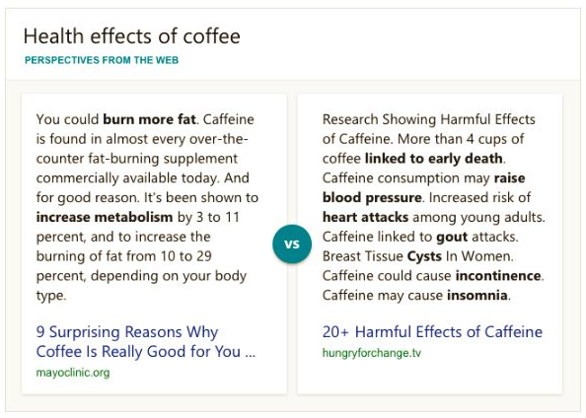
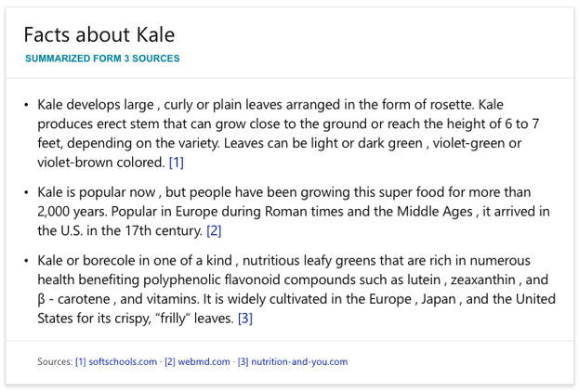
Search Interaction
Query-response model:
Search engines use query-response model
Intent inferred from query and solutions offered via ranked result lists
Search interaction is evolving – desktop to mobile, one-turn to
dialog, command-line to natural, general to personal, ad hoc to contextual, …
Query-response model serves some needs
  Better support with new answers, e.g. aggregation:
More support is needed:
  To better understand users/tasks/context
  Support end-to-end task completion
Bing “intelligent answers”:

Slide 3
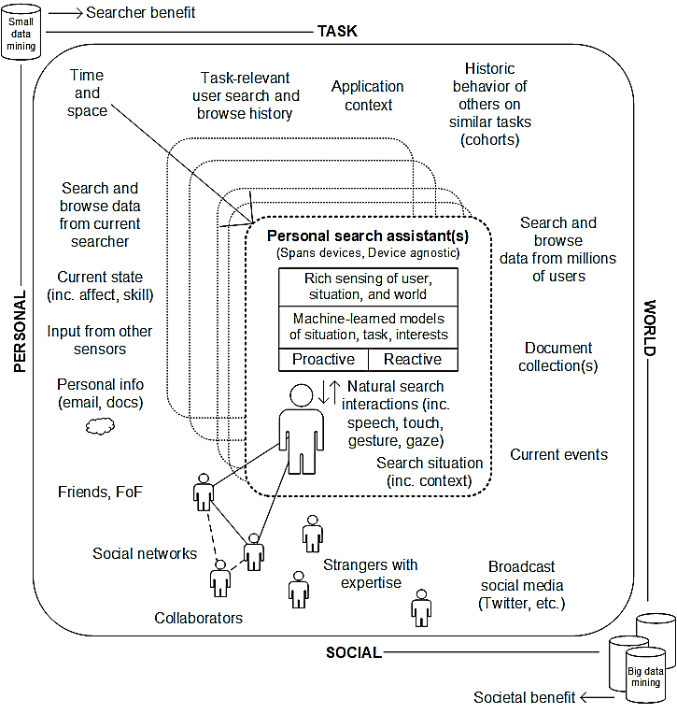
Personal Perspective on Search Interaction
User is the focus
Rich sensing to understand user interests, intentions, experiences
Situational, user, task understanding
Mixture of reactive and proactive
Natural interactions
Using data/content/expertise
Searcher benefit and societal benefit
Balancing privacy and utility
See White. “Interactions with Search Systems” Cambridge University Press, 2016

Slide 4
Examples of Challenges in Search Interaction
UNDERSTANDING
SEARCH INTERACTION
SUPPORTING
SEARCH INTERACTION
USING
SEARCH INTERACTION
Challenge: Limited knowledge of searcher intent, including one-shot queries
Challenge: Context free – missing factors that affect needs and behaviors
Challenge: Not “last mile” – only start points not end-to-end support for task completion
Challenge: Limited support for new form factors – audio output, skill discovery
Challenge: Limited user inferences – focused only on interests/intents (but not experiences, which drive interests/action)
Challenge: Biased search interaction data and user concerns about privacy
Deep dive on an example of my work in each area
Common theme: Improving search using richer user and task modeling

Slide 5
Understanding Search Interaction
Learning by observing and asking searchers

Slide 6
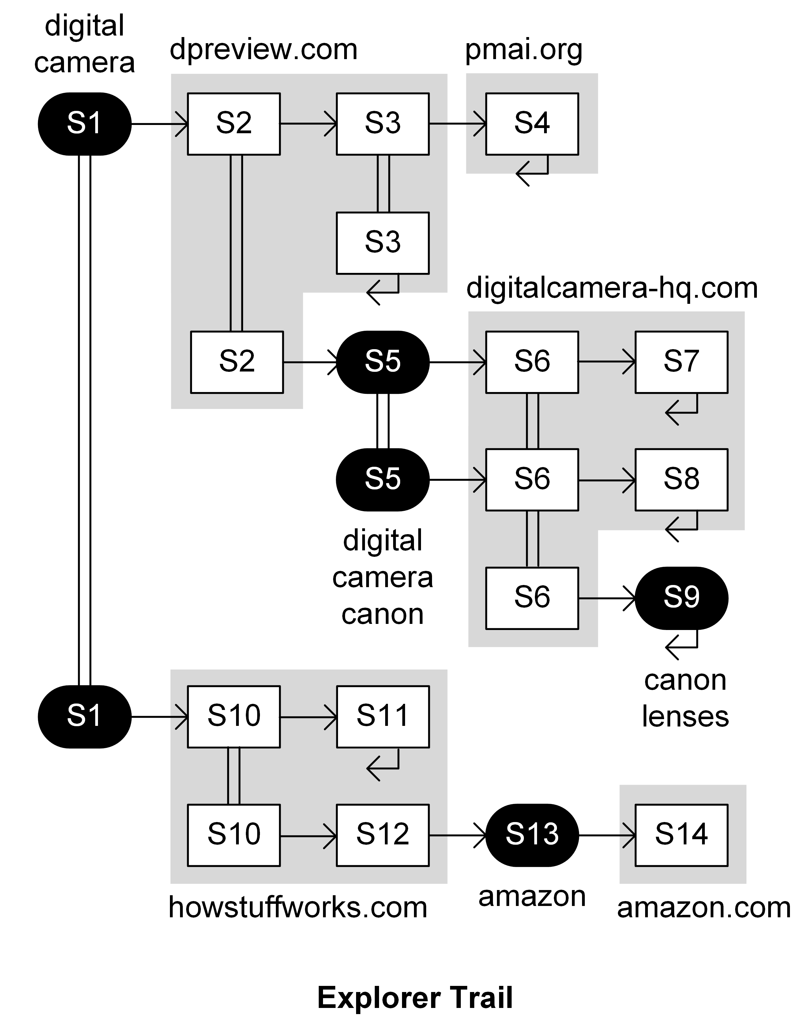
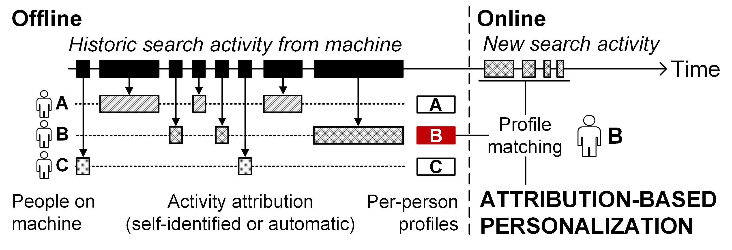
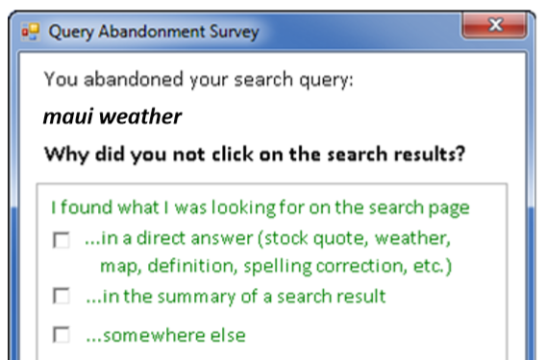
Understanding Search Interaction
Focused primarily on novel activity analysis, e.g.,
  Moving beyond result clicks to trails mined from browser logs:
  Activity attribution in
  multi-user settings such as
  shared / family devices:
  Physiological sensing at scale via
  wearable devices (Microsoft Band):
  Cursor tracking at scale in Bing
Combined methods to obtain more insight than logs
  Extensive use of surveys, user studies, panels, etc.
WWW 2014, SIGIR 2015
WWW 2007, SIGIR 2007, …
  (+ strong relevance gains)
SIGIR
2017
SIGIR 2011, CIKM 2012

Slide 7
Deep Dive on Biases
(White. “Beliefs and Biases in Web Search” SIGIR 2013 (best paper))
Understanding Search Interaction

Slide 8
Bias in Search and Elsewhere
In search, e.g.
Domain bias – People prefer particular Web domains
Rank bias – People favor high-ranked results
Caption bias – People prefer captions with certain terms
In psychology, e.g.
Anchoring-and-adjustment, confirmation, availability, etc.
All can impact user behavior

Slide 9
Biases and Search Behavior
Bias can be observed in IR in situations where searchers seek or are presented with information that significantly deviates from a known or accepted truth
Focus on set of Yes-No questions in Health domain
~2% of Bing queries in 2013 were Yes-No questions
User behavior
Search engine behavior

Slide 10
Initial Exploratory Questionnaire
Gain early insight into possible biases in search
Focus on Yes-No questions for simplicity
Microsoft employees; recall recent Yes-No query (in last 2 weeks)
Asked about belief beforehand and afterwards
  Multi-point scale: Yes / Lean Yes / Equal / Lean No / No
200 respondents. Recalled questions such as:
  “Does chocolate contain caffeine?”
  “Are shingles contagious?”

Slide 11
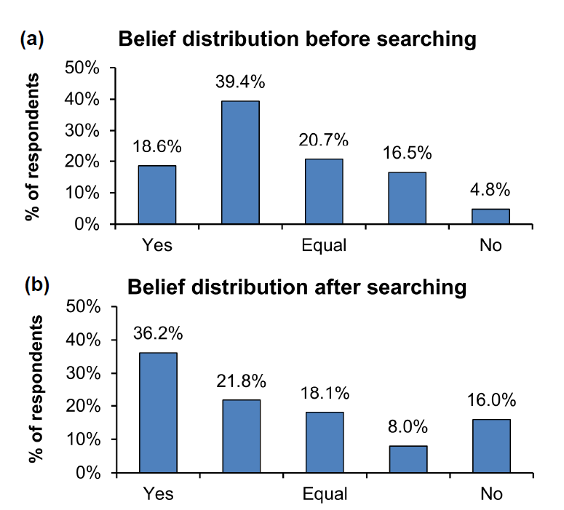
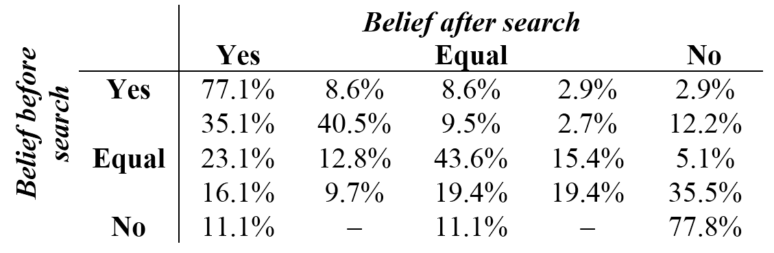
Survey Results
Two main findings:
  Respondents kept strongly-held beliefs (Yes-Yes and No-No)
  If Before = Equal, then 2x as likely to believe Yes after search
Motivation to:
Further explore possible impact of biases on behavior and outcomes
Confirmation?
Post-search belief given Pre-search belief

Slide 12
Log-Based Study of Yes-No Queries
Queries, clicks, and results from Bing logs (2 weeks)
Mined Yes-No questions: start with “can”, “is”, “does”, etc.
Focused on health since given importance. Answers were obtainable.
Randomly selected set of 1000 Yes-No health questions
  Each issued by at least 10 users, same top 10, same captions
Examples include:
  “Is congestive heart failure a heart attack?” (answer = No)
  “Do food allergies make you tired?” (answer = Yes)

Slide 13
Answer Labeling
Yes-No Answer labels for captions/results
Physician answers for Yes-No questions
Example Caption Labels
Yes only
Captions and result content
Crowdsourced judges (took consensus)
Task was to assign label of:
  Yes only
  No only
  Both (Yes and No)
  Neither (not Yes and not No)
Agreement on 96% of captions
Performed similar labeling for each top 10 search results
  Crowdsourced judges, agreement on 92% of pages
No only
Both
Neither

Slide 14
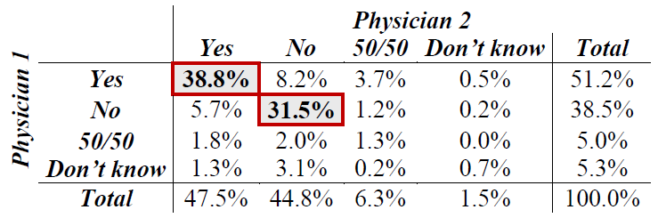
Physician Answers
Two physicians reviewed the 1000 questions and provided answers
  Inc. 50/50 = need more info, Don’t know = really unsure
Agreement between physicians on Yes-No was 84% (κ=0.668)
Focused on the 680 questions where both agreed Yes or No
Distribution: 55% Yes and 45% No (used as GROUND TRUTH in study)

Slide 15
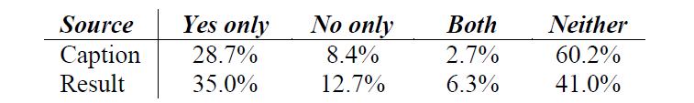
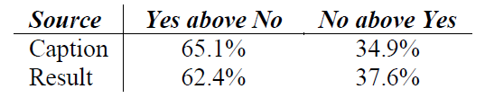
Result Ranking
Volume of Yes-No content in the results
Percentage of captions or results with answer
→ More Yes content in top-10 than No content
Relative ranking of top Yes-No content when both in top 10
Percentage of SERPs where top Yes caption or result appears
above (nearer the top of ranking than) the top No
→ Yes content ranked above No more often (when both shown)
NB: Millions of searchers/queries. All diffs are stat sig.

Slide 16
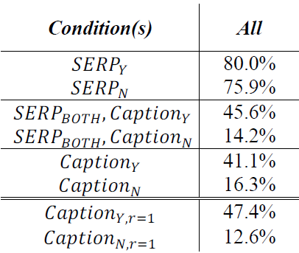
User Behavior (Clickthrough rate)
Studied clickthrough rates on captions containing answers
Controlled for rank by just considering top-ranked result (r=1)
SERP click likelihoods for different captions given variations
in answer presence in SERPs/captions, and rank
3-4x as likely to click on captions with Yes content, even though TRUTH =
55% Yes / 45% No
Just considering
top search result

Slide 17
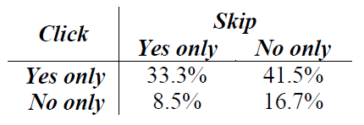
User Behavior (Result skipping)
Studied result skipping behavior
Frequency with which people skipped
caption w/answer to click other caption
Distribution of clicks and skips by answer
Users more likely (4x) to skip No to click Yes than vice versa
Caption 1
No
Caption 2
No
Caption 3
No
Caption 4
Yes

Slide 18
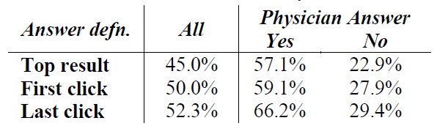
Answer Accuracy
Examined accuracy of the top search result, as well as first click and last click in session
Findings show:
  Top result accurate only 45% of the time, less when truth is No
  Users improve accuracy, but only slightly (limited by top 10 options)

Slide 19
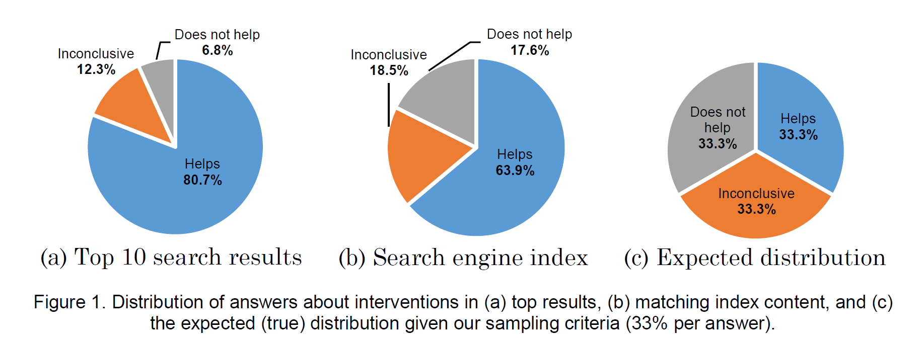
Possible Sources of Bias
Possible causes for observed rank bias include:
  Search engines use behavior (hurt by common misconceptions)
  Ranking algorithms consider query match
    e.g., for query: [can acid reflux cause back pain?]:
    Yes docs w/ “Acid reflux can cause back pain” better match (6 of 6 terms) than No docs w/ “Acid reflux cannot cause back pain” (5 of 6 terms)
    Availability – more may be
    written about positive outcomes
    e.g., for medical interventions:
missing from query
White, Hassan, ACM TWEB 2014

Slide 20
Main Findings on Biases
Bing ranked Yes above No and returned more Yes
Users more likely to click Yes than No, even when control for availability and rank position
Search engine had wrong answer at top rank for 50% of questions
Need to consider behavioral and content biases in logs and results, e.g.,
  Building better click prediction models¹
  Measuring biases in content and ranking algorithms²
  Modeling user biases using long-term behavior
    → Drop or downweight users with strong biases?
¹ White, Horvitz, ACM TWEB 2015
² White, Hassan, ACM TWEB 2014

Slide 21
Examples of Challenges in Search Interaction
UNDERSTANDING
SEARCH INTERACTION
SUPPORTING
SEARCH INTERACTION
USING
SEARCH INTERACTION
Challenge: Limited knowledge of searcher intent, including one-shot queries
Challenge: Context free – missing factors that affect needs and behaviors
Challenge: Not “last mile” – only start points not end-to-end support for task completion
Challenge: Limited support for new form factors – audio output, skill discovery
Challenge: Limited user inferences – focused only on interests/intents (but not experiences, which drive interests/action)
Challenge: Biased search interaction data and user concerns about privacy

Slide 22
Supporting Search Interaction
Helping people find and understand relevant information, faster

Slide 23
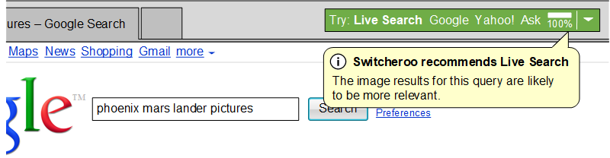
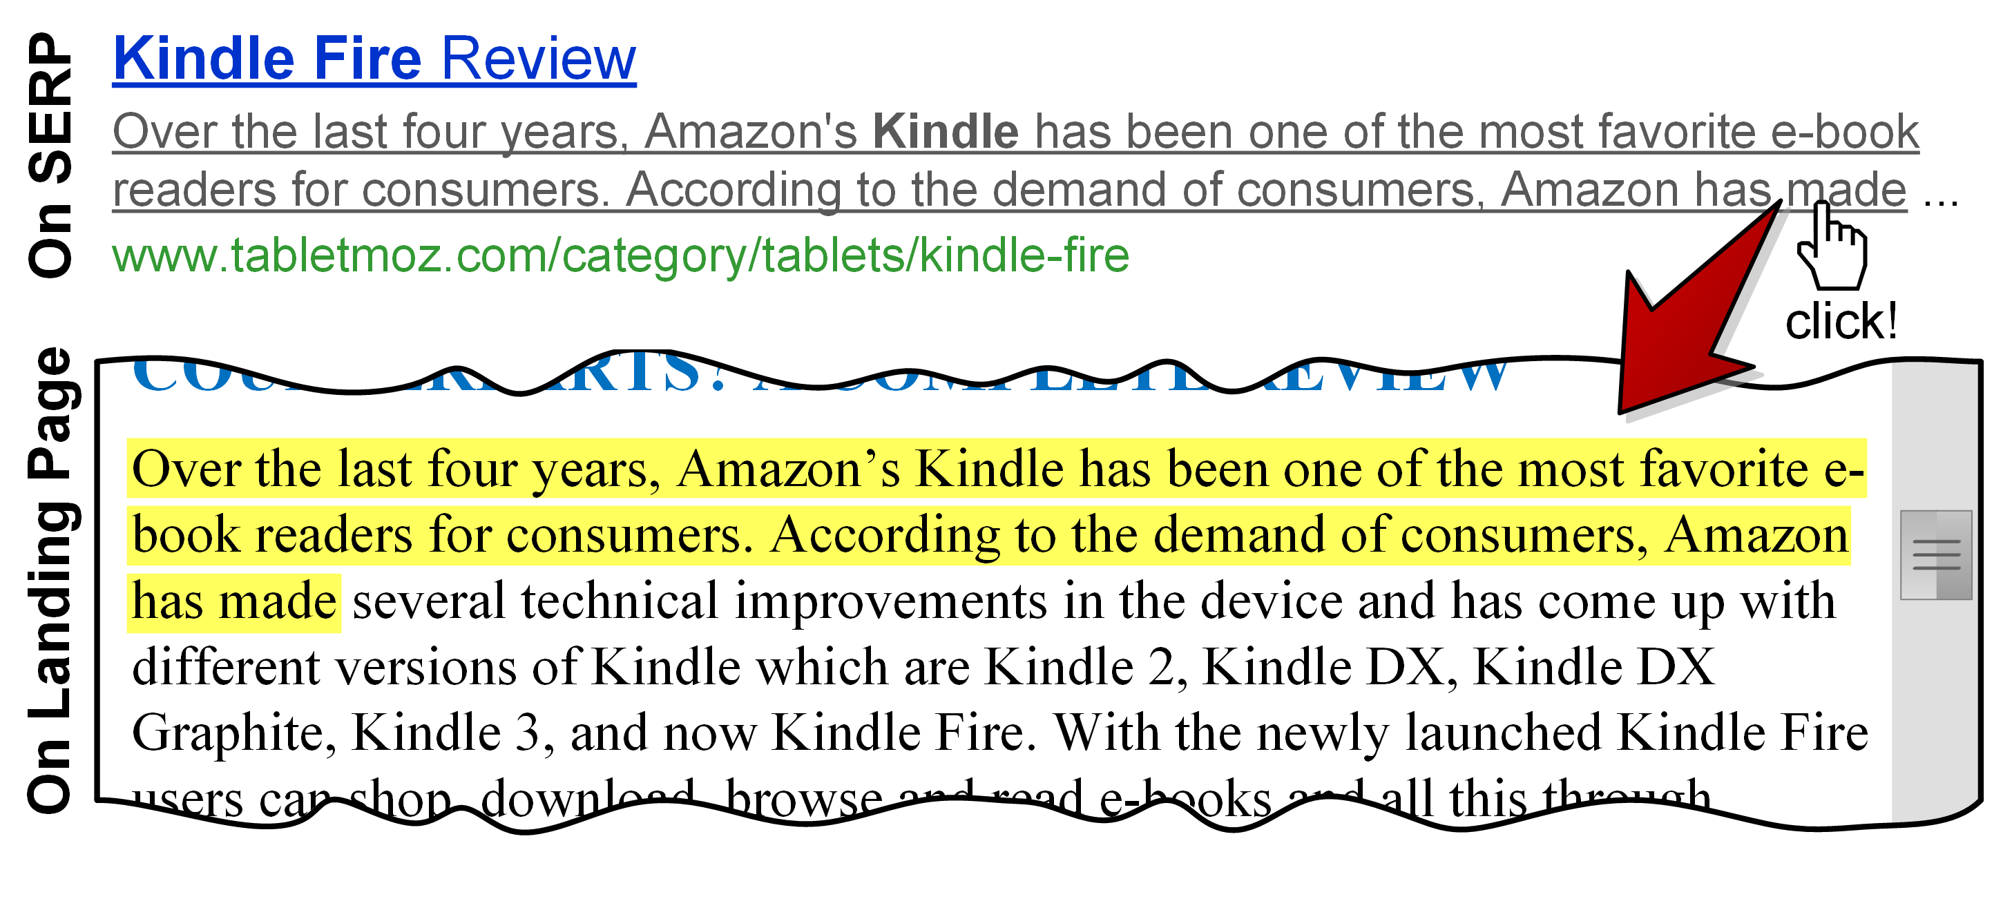
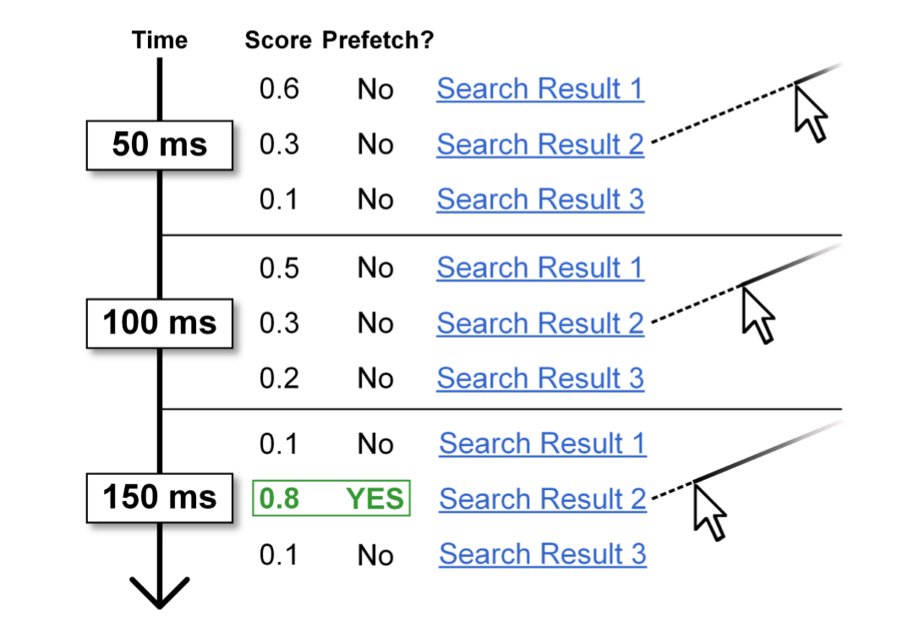
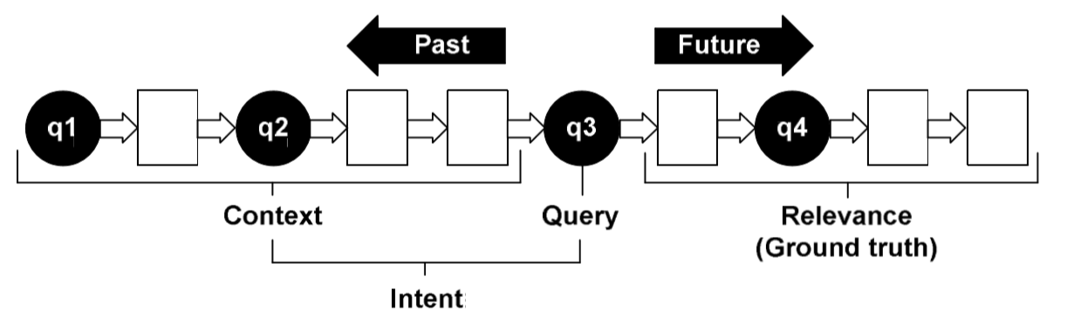
Supporting Search Interaction
My research has spanned many interactive and algorithmic solutions
Interactive support, e.g.,
  Search engine switching suggestions:
  Clickable snippets – select
  snippet text to jump to
  that part of search result:
Algorithmic support, e.g.,
  Pre-fetching results using pre-click cursor trajectories:
    Fetching results before users click on them
  Contextual ranking via previous session data,
  location, reading level, etc.:
SIGIR 2008
SIGCHI 2013
SIGIR 2016, ACM TOIS 2017
CIKM 2010, SIGIR 2012, …

Slide 24
Supporting Search Interaction
Deep Dive on Contextual Skill Discovery
(White. “Skill Discovery in Digital Assistants” Communications of the ACM 2018)

Slide 25
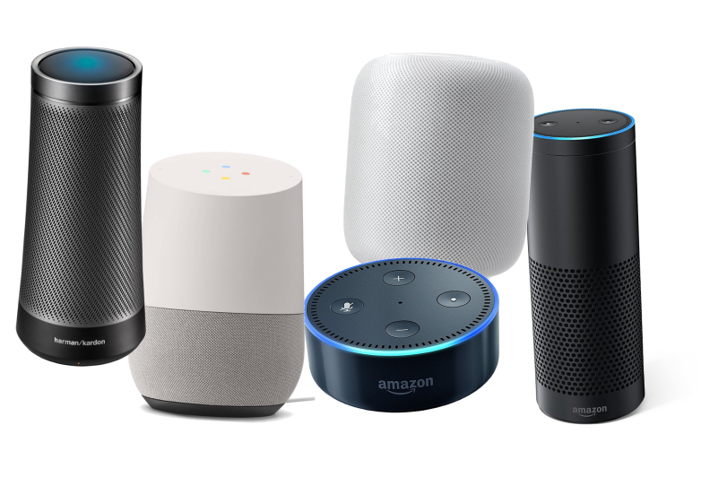
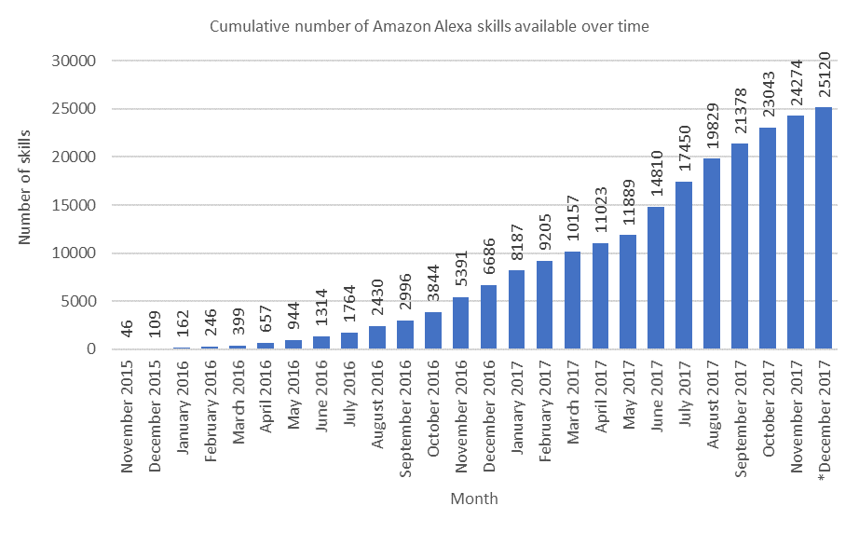
Skill Discovery
Intelligent assistants have a lot of capabilities
Affordances unclear, esp. on headless devices
  NL requests/commands based on user expectations
Number of skills growing rapidly over time
  User attention still focused on top 100 skills
  Top-100 Alexa skills (0.4%) comprise >2/3 of
  skills-related search clicks on Bing
Help is often best offered at the time of need
  More likely to stick and be remembered later
  Users are likely to forget if skill suggestions are separated in time (e.g. periodic emails)
Headless devices (smart speakers)
Cumulative # of Alexa skills over time
25k+
* Only partial data available for December 2017

Slide 26
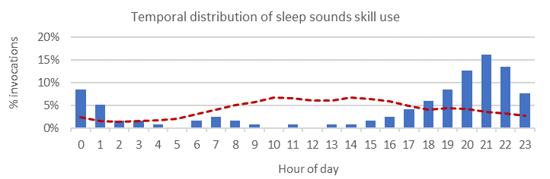
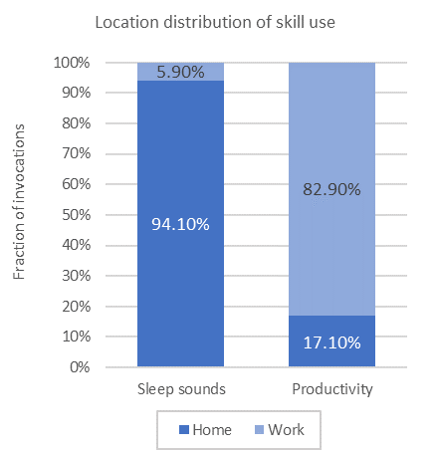
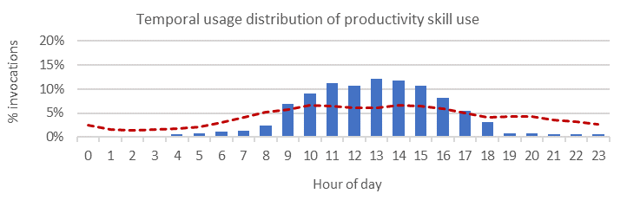
Role of Context
Context is an important determinant of skill relevance and assistant utility
Analysis of skill usage data shows usage varies depending on context
E.g., from analyzing Cortana data from internal deployment:
Sleep skills used more at home in the evenings
Productivity skills used more at work during the day
Sleep sounds
skill
% of all invocations for each skill at two user-defined locations: home and work
Productivity
skill
All skills
@Home
@Work
Local time and location are important context signals that are easy to obtain

Slide 27
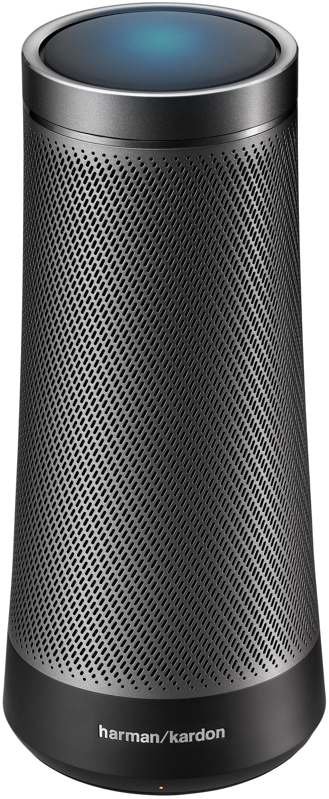
Contextual Skill Recommendation
User
Hey Cortana,
help me now!
Learn skill recommendations based on context
Support query-less / context-only skill suggestion
Generate set of contextual features from Cortana data
Also use personal features (prior skill usage)
Features in three classes:
Assistant
Here’s what I can do to best help right now …
User
Let’s …
Feature class | Description | Example features
Popularity | General popularity of the skill across all users (using only historic usage data from before the skill was invoked) | Historic skill usage count, historic skill user count
Context | Contextual signals describing when the skill is used | Calendar (meeting duration, subject*), visited venues (type, duration, name*), local time, to-do list items*, search queries (in last 30 mins*, in last 30 days*), applications used*, etc.
Personal | Features corresponding to the user who invoked the skill, e.g. popularity of the specific skill for that specific user | Historic skill usage by current user within the last 30 mins, within the last 30 days, and all time
Text features (*), are first in continuous semantic space (300-dimension concept vector, using Sent2Vec), and compute cosine similarity with both skill name and skill description

Slide 28
Evaluation
Setup similar to click prediction task from search and advertising
At each point in time (t) we have:
  Context and personal signals
  All skills known to the searcher – used at least once before t
  Skill that was invoked (positive example)
  Skill(s) that were not invoked (negative examples)
Five months of skill invocation + context data from Cortana
  Train on first 16 weeks, test on last 2 weeks
Task is to learn to predict the invoked skill – can also be used for recommendation
Previous skill
invocations
Skill
invoked
Time
@ time t in
context C
Learn to rank
Current skill ∪
Previous skills

Slide 29
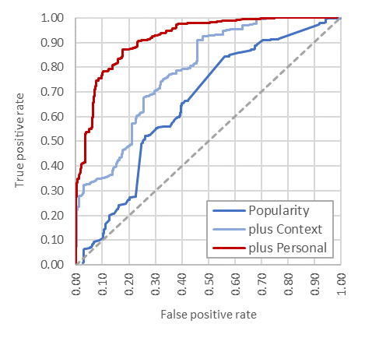
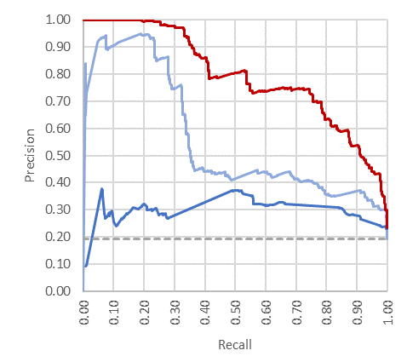
Results (1) – Predicting Skill Invocation
Results show reasonable performance at skill invocation prediction
Popularity AUROC=0.651, +Context AUROC=0.786, +Personal AUROC=0.918
+Context
+Personal
Baseline of always predict skill utilization (19% precision)
Receiver-operator characteristic curves
Precision-recall curves
Context features improve precision, personal features improve recall

Slide 30
Results (2) – Feature Weights, Unseen Skills
Most important features in full model:
  Skill popularity (both for the current user and globally)
  Calendar (what the user is doing right now)
  Short-term interests (in this case, recent web search queries)
Reliance on historic data (popularity) limits model applicability to “seen” skills
Re-ran experiments for just cases where skill is invoked for first time
  AUROC=0.894 → Results may generalize to “unseen” skills

Slide 31
Main Findings on Discovery
Contextual skill recommendation seems feasible with good accuracy
Contextual and personal signals help in different ways
Can also help on devices with screens (Echo Show), since space is limited
Need to examine other contextual signals (e.g., co-presence, conversations)
Need richer task modeling – understand user task at suggestion time
If recommendations made proactively, need careful gating of notifications
Policy questions about personal versus group sharing (avoid TMI)

Slide 32
Examples of Challenges in Search Interaction
UNDERSTANDING
SEARCH INTERACTION
SUPPORTING
SEARCH INTERACTION
USING
SEARCH INTERACTION
Challenge: Limited knowledge of searcher intent, including one-shot queries
Challenge: Context free – missing factors that affect needs and behaviors
Challenge: Not “last mile” – only start points not end-to-end support for task completion
Challenge: Limited support for new form factors – audio output, skill discovery
Challenge: Limited user inferences – focused only on interests/intents (but not experiences, which drive interests/action)
Challenge: Biased search interaction data and user concerns about privacy

Slide 33
Using Search Interaction
Employing search data to improve services, understand users, and evaluate performance

Slide 34
Using Search Interaction
Search logs offer limited but highly useful lens on interests and intents
Used for many applications in ranking, advertising, evaluation, etc.
Can also capture experiences, which shape activities and decisions
Recently focused on log signals for various health experiences
Projects include:
  Temporal patterns of pregnancy searching – Fourney, White, Horvitz (SIGCHI 2015)
  Monitoring evolving interests in cancer – Paul, White, Horvitz (ACM TWEB 2016)
  Detecting adverse drug reactions from searches – White et al. (Nature CPT 2014)

Slide 35
Deep Dive on Mining Log Data for Disease Detection
(Paparrizos, White, Horvitz. “Screening for Pancreatic Adenocarcinoma using Signals from Web Search Logs” J. Oncol Pract. 2016)
(Paparrizos, White, Horvitz. “Detecting Devastating Diseases in Search Logs” SIGKDD 2016)
Using Search Interaction

Slide 36
Background
Logs offer insight into symptoms and conditions that users experience
Log-based sensing can be integrated with everyday search activities
Retrospective analysis at population scale for building ML models for detection and/or forecasting tasks
Insights can power alerting systems and support clinical diagnosis

Slide 37
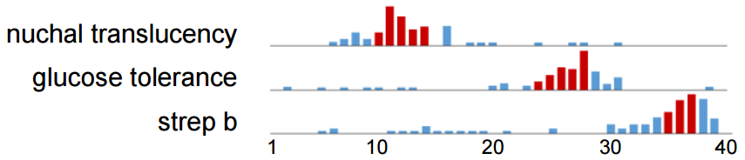
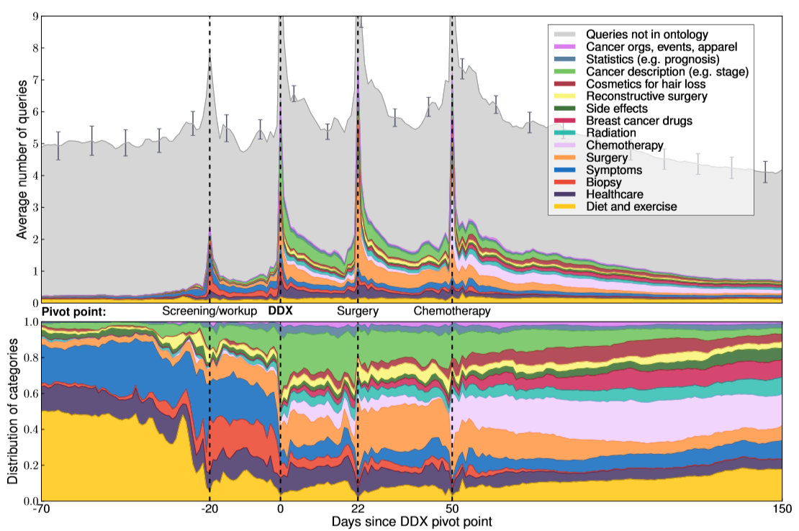
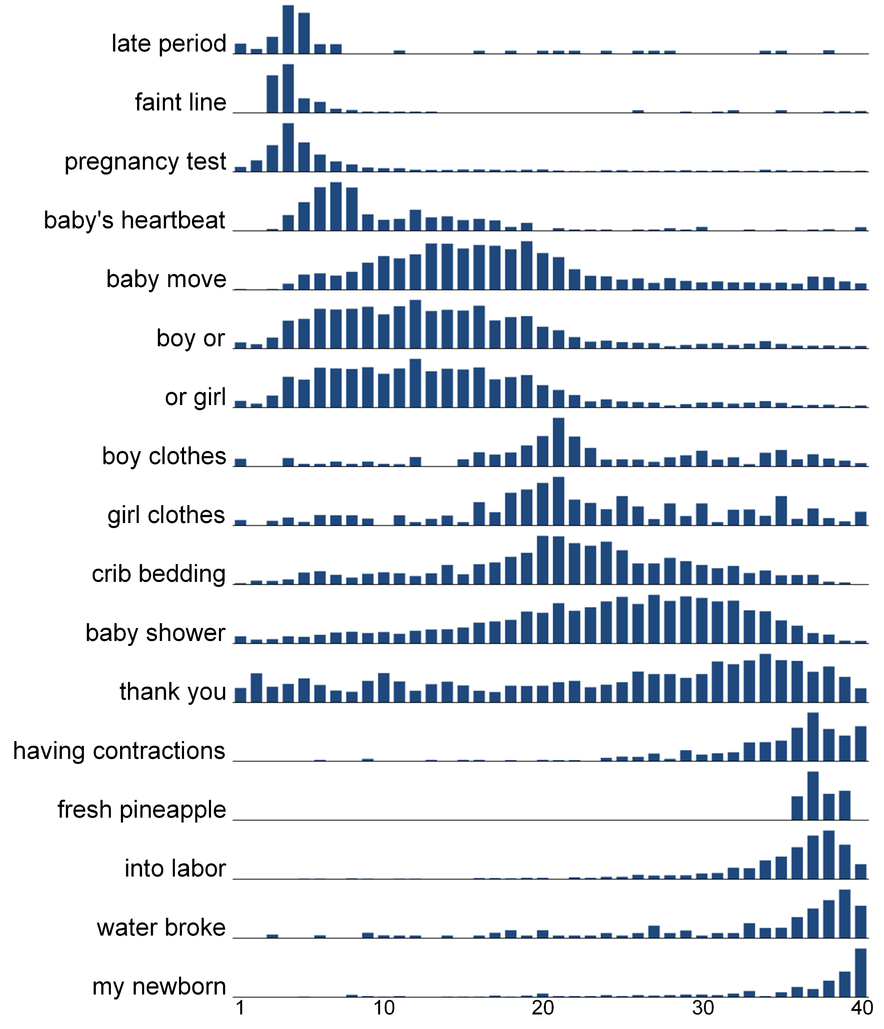
Experiential Timelines
Relationship to
when tests are
performed
Experiential queries to identify landmarks for each user; align users on those
Long-term breast cancer searching¹
Patterns in long-term pregnancy searching²
First experiential
BRCA DX search
Due date from self-report timing e.g. “I am 25 weeks pregnant”
¹ Paul, White, Horvitz. ACM TWEB 2016
² Fourney, White, Horvitz. SIGCHI 2015
Notes:
Algorithm:
Select features (n-grams) based on info gain
from users with self-report queries + in a
narrow range of gestational weeks
Take all queries from user over time
Assign queries to temporal distributions
Fit to a linear model via linear regression (Thiel-Sen non-parametric estimation)
If line slope 0.85-1.15, user → pregnant
Improves coverage beyond self-reporting searchers (8x increase in coverage)

Slide 38
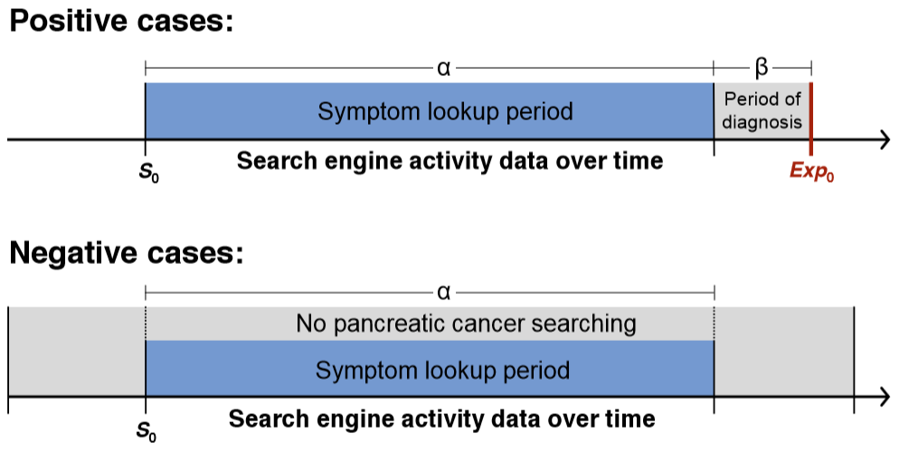
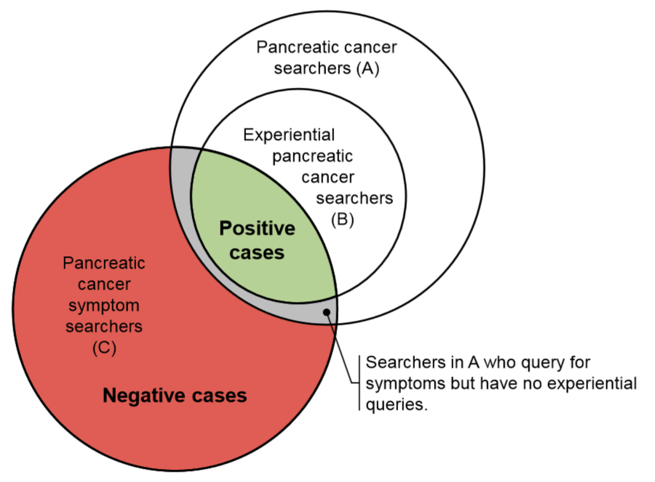
Self-Report Queries to Identify PANCA Sufferers
Pancreatic cancer highly aggressive: <18mo from Stage I to Stage IV
1072 Bing searchers had an experiential PANCA query + prior symptom
Assume are as reliable as survey responses, especially since unprompted
Experiential queries e.g.,
“i was told i have pancreatic cancer what to expect”
“why did i get cancer in pancreas”
n=1,072
“just diagnosed with pancreatic cancer”
First symptom search
First experiential search
n=3,025,046
First symptom search
NB: Negatives were sub-sampled so that α distribution is similar to positives
Notes:
But placing

Slide 39
Predicting Pancreatic Cancer from Log Data
Task: Early detection of experiential searches for pancreatic cancer
Binary classification at time t, using MART because it is robust to noise and focusing on recall at low FP rates, given the cost of misclassification
Features of the search activity before the first experiential query
  Statistics on symptoms (back pain, yellow eyes, etc.)
  Statistics on risk factors (pancreatitis, alcoholism, obesity, etc.)
  Temporal characteristics – trends and features computed over different horizons
  Query-URL visits – topical categories
  Also used demographics – proprietary Bing classifiers of age and gender

Slide 40
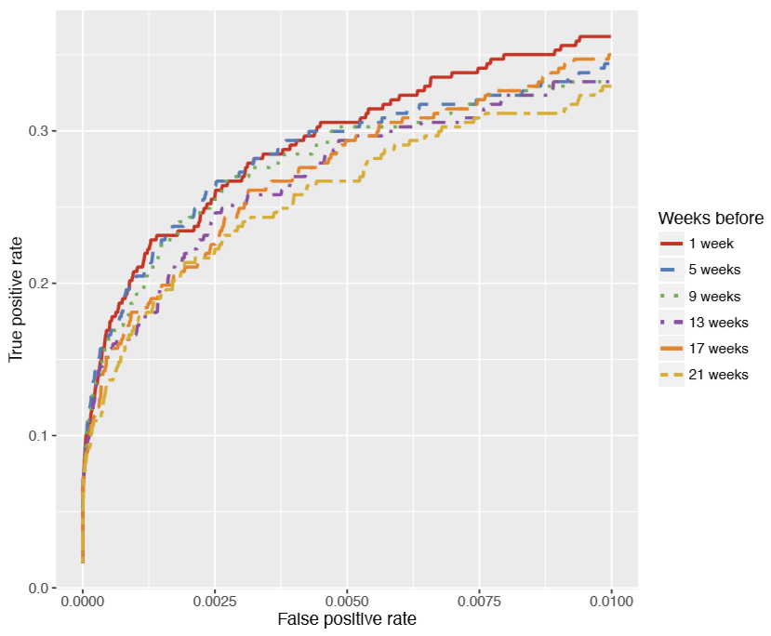
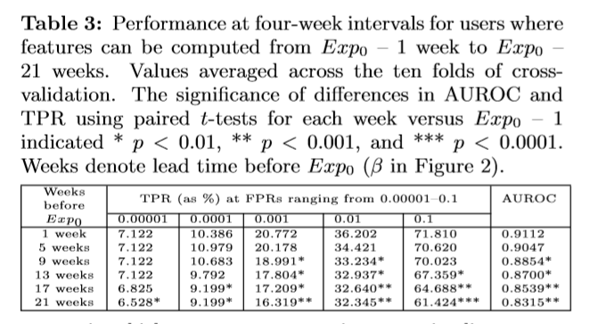
Results (1)
Focus on lower-left region of ROC curve given the high cost of misclassification, e.g.,
Heightened user anxiety
Unnecessary healthcare costs
Overall prediction performance is strong AUROC=0.9003
  High AUROC expected given base rate
  Focus on TPR at low FPR
Predict the occurrence of the experiential query at different
lead times before Exp₀

Slide 41
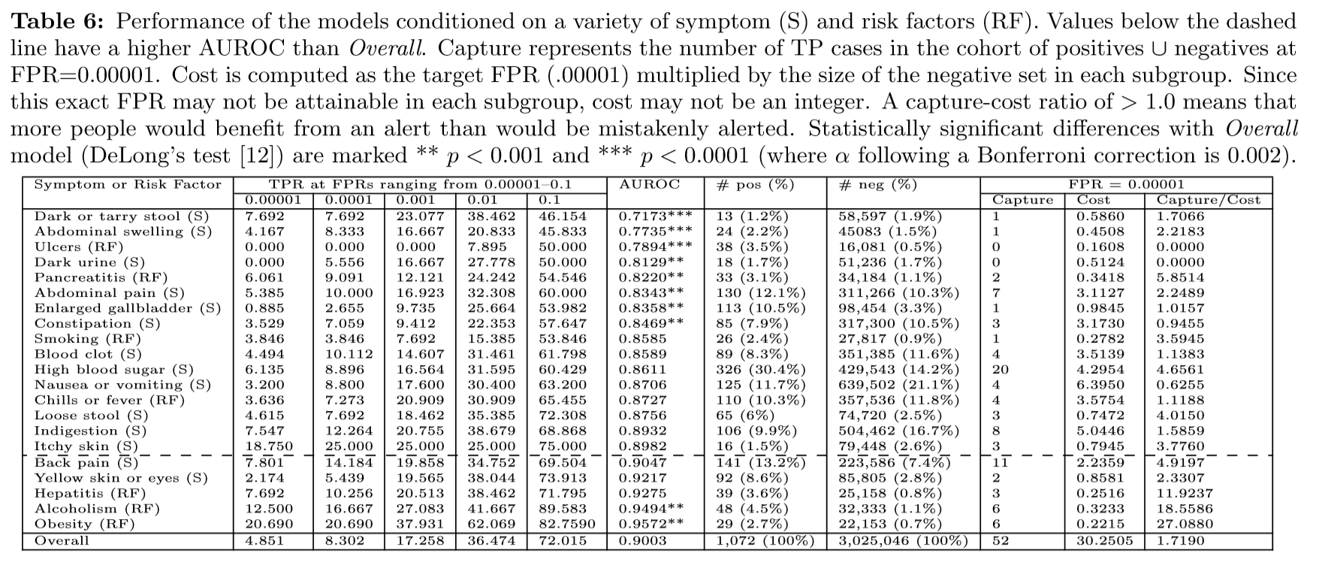
Results (2) – Conditioning on Symptoms / Factors
Increasing performance
Conditioning on certain RFs and symptoms leads to better performance
Capture (expected value of early detection) / cost (e.g. unnecessary anxiety) varies per condition
  Decision analysis could be applied to help find optimal ratio, including engagement methods

Slide 42
Main Findings on Health Experiences
Records of search interaction feasible for experiential modeling
Logs offer limited insight and ground truth difficult to obtain
  Need follow-up studies with real patients
    Get ground truth on DX
    Better understanding user situations
  Need to carefully design roll-out and user experience
Follow-on research with similar approaches:
  Forecasting lung cancer with queries and environmental data¹
  Detecting neurodegeneration with queries and mouse cursor data²
¹ White and Horvitz, JAMA Oncology 2017
² White, Doraiswamy, Horvitz, Nature Digital Medicine 2018

Slide 43
Overall Summary
Search interaction extends well beyond just query-response
Focused on understanding, supporting, and using search interaction
Overview of some of my work + deep dive in three areas:
  Understanding – Biases
  Supporting – Skill Discovery
  Using – Health Experiences
Many challenges but also many opportunities to help searchers …

Slide 44
Some Opportunities in Search Interaction
Per my specific interests going forward:
UNDERSTANDING
SEARCH INTERACTION
SUPPORTING
SEARCH INTERACTION
USING
SEARCH INTERACTION
Challenge: Limited knowledge of searcher intent, including one-shot queries
Opportunity: Conversational search – dialog to better support complex needs
Challenge: Context free – missing factors that affect needs and behaviors
Opportunity: Task modeling – richer contextual sensing and task-specific search support
Challenge: Not “last mile” – only start points not end-to-end support for task completion
Opportunity: Supporting end-to-end task completion (e.g., via first-party and third-party skills, web “macros”)
Challenge: Support for new form factors – audio output, skill discovery
Opportunity: Search interaction with situational constraints (e.g., smart speakers)
Challenge: Limited user inferences – focused only on interests/intents (but not experiences, which drive interests/action)
Opportunity: Experiential user modeling and applications thereof (esp. in health)
Challenge: Biased search interaction data and user concerns about privacy
Opportunity: De-biasing search data and building transparent ML models (with explanations for users)
See White “Opportunities and Challenges in Search Interaction” CACM 2018

Slide 45
Thank You
Questions?

